Slide 1

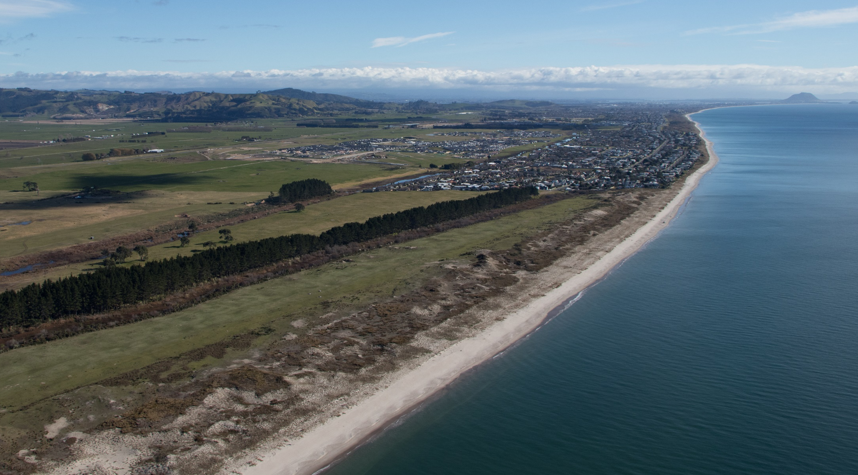
26 February 2022 | Engagement Hui No #2

Slide 2

Preliminaries / House Keeping
Karakia
Introduction of Facilitator, Trustees and Support Team
Owners must register – Amber Taare will message if details are required
Hui Protocols: Hui will be recorded and made available on the website to owners. This presentation will also be posted on the website.
Webinar style via Zoom: How to participate by asking questions or giving feedback or giving apologies? Use the Q&A function;

Slide 3

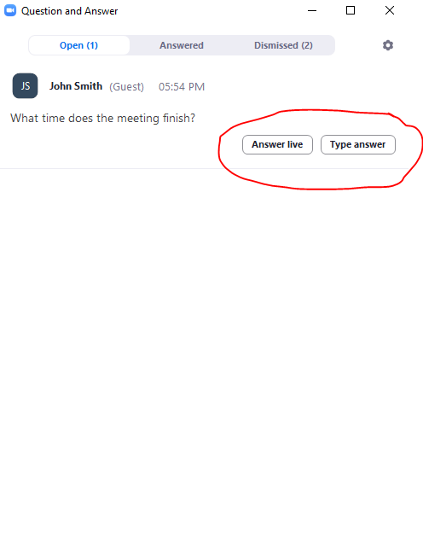
Asking questions or providing feedback

Slide 4
Hui Agenda
Karakia and Preliminaries
Engagement Hui Process and Purpose
Summary of Feedback from Engagement Hui #1
Cultural and Historical Overview
Court of Appeal Decision
Trustee Guiding Principles.
Proposal for Trustee Rotation and Elections.
Te Tumu Development Update.
Options and Process for Infrastructure Corridors.
Next Steps.

Slide 5
Engagement Hui Process & Purpose
Four Engagement Hui are planned to provide Beneficial Owners the opportunity to consider and provide feedback and input on (1) proposed Trustee Rotation and Election Policy and (2) Options for development of Trust lands.
Hui #1 – 13 Feb 2022 (Presentation of Trust information and options). Complete.
Hui #2 – 26 Feb 2022 (Presentation of Trust info and options; Q&A responses from Hui #1).
Hui #3 – 13 March 2022 (venue and details TBC).
Hui # 4 – 9 April 2022 (Venue and details TBC).
Engagement Hui timing and format is being developed based on Covid restrictions and owner feedback to provide for maximum owner participation.
As the Engagement Hui are held, resolutions will be developed with feedback, leading to a Postal Vote on formal resolutions.
TK14 website is being regularly updated with information and feedback.

Slide 6
Summary of Engagement Hui #1
Questions on engagement processes:
  Q1: How much has been spent to date on the development?
  A1: Financial details are being posted on the website to answer this question.
  Q2: How are the Trustees ensuring maximum participation in these important hui?
  A2: The Trustees have updated the website and setup a TK4 Facebook page, which is interactive. In addition they have been actively seeking contact details for all beneficial owners. Opportunities for speaking rights at hui are being provided, along with chat function and Q/A function. A postal vote is considered the most appropriate formal approach to voting.
  Q3: What experience and skills do the current trustees have?
  A3: Trustee bio details will be posted on the website.
  Q4: Can a postal vote occur when not specified in the Trust Order yet?
  A4: Yes, trustees are entitled to respond to Covid hui restrictions and seek ways to reach as many owners as possible. Feedback from owners is also sought on this process.

Slide 7
TE TUMU KAITUNA 14
TE TUKUNGA IHO

Slide 8
TE ŪNGA MAI ME TE WHAKANOHONOHO
1350 – 1500
It is generally believed that Te Arawa canoe arrived about 1350.
For the next five generations Te Arawa had settled the area from Mauao to beyond Pukehina, and the inland country to Rotorua.
Gradually the people of Te Rangihouhiri – Ngāi Te Rangi – moved into the area. A series of skirmishes resulted in the battle of Pōporohuamea, and Maketū and the surrounding area was taken.
Not long after Mauao and other parts of Tauranga were taken from Waitaha by Ngāi Te Rangi at the battle of Te Kōkōwai.

Slide 9
TE HOKINGA ATU
1500 – 1835
Waitaha and Tapuika remained settles around their respective mountains of Ōtawa and Rangiuru maintaining an uneasy peace with Ngāi Te Rangi.
Gradually the inland Te Arawa based around Rotorua returned to the area as allies and relations of Waitaha and Tapuika, some even settling at Maketū.
Inland wars between Te Arawa and Tainui spilt over to the coast, wherby Te Waharoa of Ngāti Hauā sacked Maketū, killing Te Ngahuru, an important chief of Ngāti Whakaue.

Slide 10
TE PAKANGA
23 April 1836
Kahawai of Ngāti Rangiwewehi grew impatient for revenge and went to Ōtawa to await the rest of Te Arawa to organize themselves.
When the rest of the inland Te Arawa and their allies from Waitaha, Tapuika and elsewhere, they attacked the pā at Te Tumu and took it.
Ngāi Te Rangi were defeated and pursued to the mouth of Te Wairākei Stream at Papamoa.
Small resultant skirmishes did not change the new boundary between Te Arawa and Ngāi Te Rangi.

Slide 11
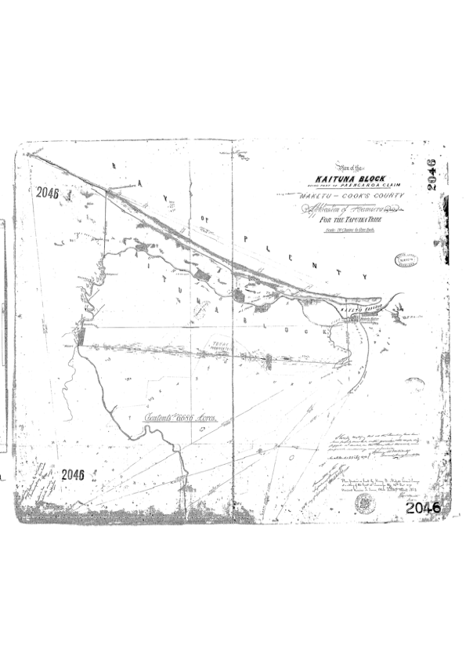
TE KOOTI WHENUA MĀORI 1
Ōtumumatawhero
Te Kōpua
Te Karaka
Te Pāroa
Te Tumu
Te Kakari
Papahīkahawai

Slide 12
NGĀ WHAKAWĀKANGA KOOTI
2 May 1883
Te Tumu Kaituna was awarded by the Native Land Court to Ngāti Tūnohopū and Ngāti Whakaue, as well as Ngāti Rangiwewehi, Ngāti Uenukukōpako and Ngāti Rangiteaorere.
The witnesses for the last three iwi were respectively Hōri Te Rahoatua, Tāmati Hapimana and Te Kiri Karamu.
Each of the hapū put in a few people from other iwi through aroha.

Slide 13
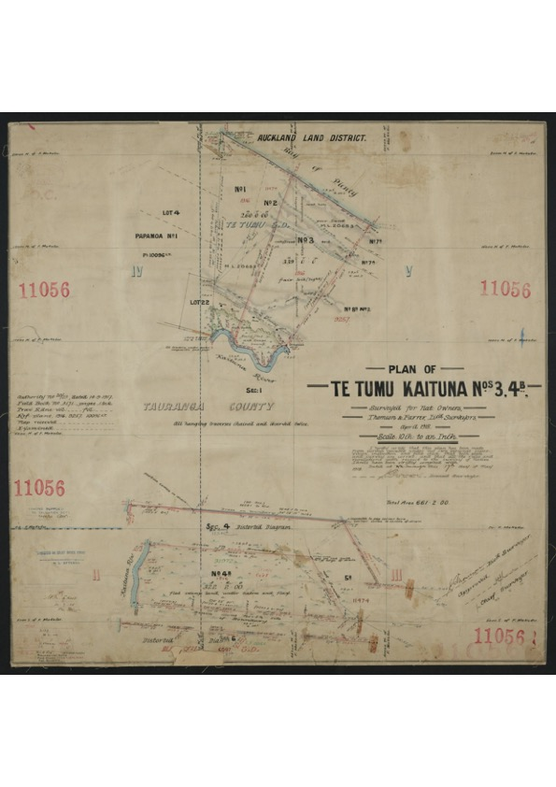
TE KOOTI WHENUA MĀORI 2
PARTITIONS
TK1 to N’Uenukukōpako 156a
TK2 to N’ Rangiteaorere 101a
TK3 to N’Rangiwewehi 333a
TK4 to N’Rangiwewehi 751a
TK5 to N’Rangiteaorere 226a
TK6 to N’Uenukukōpako 353

Slide 14
TE KOTIKOTI WHENUA
28 Aug 1890
Te Tumu Kaituna was partitioned into 13 blocks, of which Blocks 3 & 4 were awarded to Ngāti Rangiwewehi, 1 & 6 to Ngāti Uenukukōpako and 2 & 5 to Ngāti Rangiteaorere.
The witnesses for the three iwi were respectively Hōri Te Rahoatua, Tāmati Hapimana and Hēmi Kōkiri.
Eventually Blocks 4, 5 & 6, were sold to the Crown. That was 1330 out of a total of 1920 acres, or nearly 70% of the land.
Blocks 1, 2 & 3 were further partitioned, but eventually amalgamated in 19__ as Te Tumu Kaituna 14, except for a small partition of Block 1 that had already been sold.

Slide 15
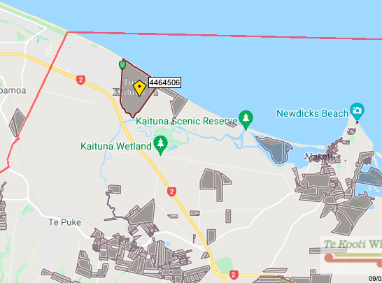
TE ROHE 2022

Slide 16
Court of Appeal Decision
Decision made on 17 December 2021 to dismiss the Trust’s appeal; key points:
Trust Proposal was based on obtaining finance to enable development and housing for the betterment of our owners.
There was no proposal to sell or partition the land, rather the proposal was to change the status of the land to facilitate its development.
Appeal was required to clarify the legal position.
Decision determined that the MLC does not have jurisdiction to make a status order conditional on a separate title being issued, it needed a separate title first.
There are now further funding opportunities which if preferred by the owners would not require the change in status of the land.
Trustees look forward to receiving feedback from owners through the website and upcoming hui.
Notes:
Refer to blog post detail sheet dated 22 January 2022 for details for each guiding principle.

Slide 17
Trustee Guiding Principles for TK14
Trustee Guiding Principles to inform the proposed development opportunities for our Whenua:
Developing the land without selling it.
Ensuring our history and cultural connection is represented and respected.
Houses for our people.
Community spaces and places for beneficial owners.
Commercial opportunities for beneficial owners.
Employment, education and training opportunities for beneficial owners.
Creation of sustainable income for beneficial owners.
Each principle will now be detailed, and we invite owner feedback and engagement through this hui process.
Notes:
Refer to blog post detail sheet dated 22 January 2022 for details for each guiding principle.

Slide 18
Trustee Guiding Principles for TK14:
Principle 1: Developing the land without selling it:
Retention of land is a priority.
Create sustainable income streams through long term leases.
Where land interests are to be encumbered for infrastructure servicing (eg long term land leases / easements) the preference is to offset the encumbrance by way of increasing overall trust land holdings (via land exchange options).
Some land for roads may require vesting for owner housing to be delivered.
Notes:
Refer to blog post detail sheet dated 22 January 2022 for details for each guiding principle.

Slide 19
Trustee Guiding Principles for TK14:
Questions & Answers from Hui #1: Principle 1
  Q1: No land should be sold / vested; why is this required?
  A1: The Trustees agree that their fundamental principle is retention of land. That is why novel approaches to land exchange or easements are being considered. If a major housing development on our land is to proceed however, then the internal local roads to service housing for owners may require vesting to secure infrastructure to service those houses. The Trustees are seeking feedback on this, particularly as to alternative approaches.
Notes:
Refer to blog post detail sheet dated 22 January 2022 for details for each guiding principle.

Slide 20
Trustee Guiding Principles for TK14:
Principle 2: Ensuring our history and cultural connection is represented and respected:
Protection of known historical, cultural and ecological sites within the block.
Appropriate naming of roads, streets, parks, cycleways and reserves that includes te reo Māori and recognises our history.
Give priority preference to our own people for employment, advisory, commercial and personal participation with our lands.
Feedback from Hui #1:
Appreciate the historical overview that was provided.
What is the current status of takutai moana claims adjacent to the TK14 whenua? Chair: There has been no competing claims to this part of the coast.
Notes:
Refer to blog post detail sheet dated 22 January 2022 for details for each guiding principle.

Slide 21
Trustee Guiding Principles for TK14:
Principle 3: Houses for our people:
Initiatives include:
Build Own Operate Transfer Model – Kāinga Ora build, own and operate affordable rental properties that cater for beneficial owners and the wider community on leasehold land, which is returned after a period of up to 25 years.
Build to Own Housing – This would likely be on a shared equity basis guaranteed by Kāinga Ora and the Tumu Kaituna 14 Trust and provided for through the Progressive Home Ownership Fund.
Community Housing – Establishing community housing development through a provider and our trust that would specifically cater to providing affordable rental accommodation for our owners and their whānau.
Transitional housing for our people without stable accommodation.
Notes:
Refer to blog post detail sheet dated 22 January 2022 for details for each guiding principle.

Slide 22
Trustee Guiding Principles for TK14:
Questions & Answers from Hui #1: Principle 3
  Q1: What will be the cost of the housing for owners?
  A1: The Trustees aspiration is to provide ownership and rental housing options for owners that are affordable.
  The Trustees have made application to TPK through the Whai Kāinga Whai Oranga fund to access funding for owner housing business case. This will enable funding requirements to be identified, including budgets to enable a strategy for affordable housing for owners to be achieved.
Notes:
Refer to blog post detail sheet dated 22 January 2022 for details for each guiding principle.

Slide 23
Trustee Guiding Principles for TK14:
Principle 4: Community spaces and places for beneficial owners :
Initiatives include:
A holiday park and campground on the coast for priority use by our owners and their whānau, which is managed by the Trust (or Trust appointed persons).
A cultural centre to show and highlight the substantive history and cultural aspects associated with the whenua.
A boat storage adjacent to the Kaituna River for use by the owners and their whānau.
Parks and reserves that will cater for a range of ages and abilities.
Sports grounds and facilities for the whole community.
Riparian protection of and access to waterways.
Notes:
Refer to blog post detail sheet dated 22 January 2022 for details for each guiding principle.

Slide 24
Trustee Guiding Principles for TK14:
Questions & Answers from Hui #1: Principle 4:
  Q1: Which trustees agreed that owners could "buy" a plot in the holiday park that was proposed on TK14?
  A1: There has been no agreement to any proposal, this is a fresh approach to engagement with owners. All options should be considered.
  Q2: why not negotiate with a major tertiary provider & centres of research & excellence to establish a Campus on this site?
  A2: Trustees appreciate the ideas and feedback.
  Q3: Māori focussed schooling, healthcare, shopping centres and land owner hosuing should be a priority.

Slide 25
Trustee Guiding Principles for TK14:
Principle 5: Commercial opportunities for beneficial owners:
Initiatives include:
Use of proposed commercial zoned land for small business establishment by owners and whānau.
Support the establishment of small businesses by owners and whānau in the form of subsidised land lease, low interest loans and business and mentoring assistance.
Notes:
Refer to blog post detail sheet dated 22 January 2022 for details for each guiding principle.

Slide 26
Trustee Guiding Principles for TK14:
Principle 6: Employment, education and training opportunities for beneficial owners:
Provide:
Training opportunities.
Employment opportunities.
Business opportunities.
Trustees actively invite ideas and feedback from owners on potential opportunities.
Notes:
Refer to blog post detail sheet dated 22 January 2022 for details for each guiding principle.

Slide 27
Trustee Guiding Principles for TK14:
Principle 7: Creation of sustainable income for beneficial owners:
Underpins the other guiding principles.
Provided through long term land and building leases.
Supports, compliments and builds on surrounding urbanisation.
Notes:
Refer to blog post detail sheet dated 22 January 2022 for details for each guiding principle.

Slide 28
General Feedback
Q1: Trustees should consider engaging advisors with strong Māori cultural experience.
A1: Feedback appreciated and noted.
Q2: Allegation that Jeff Fletcher has a conflict of interest because of his involvement with Ford.
A2: A full response on the website. Jeff provides advice to TK14 independent of any work associated with the Ford land. Jeff’s association with the Ford land was openly disclosed and does not create a conflict for the Trust. The allegation of conflict was raised in the MLC and dismissed.
Q3: Voting; will it be a poll vote or one vote per owner and whanau trust?
A3 Voting will follow the Māori Assembled Owner Regulations.

Slide 29
Proposal for Trustee Rotation and Elections:
Seven trustees be elected for five years.
Elections every two years (for two positions) to provide for rotation of trustees.
Current trustees would retire two at a time over the next three elections.
Retiring trustees can seek re-election.
Trustees would be elected by postal vote and nominees should have:
Seven years experience in Māori land governance or administration, law, commerce or management; or
An NZQA-approved tertiary qualification Māori land administration, or business administration or management.
Trust Order Variation is required subject to broad support of owners.

Slide 30
Proposal for Trustee Rotation and Elections:
Questions & Answers from Hui #1:
  Q1: Are the Trustee requirements re 7 years experience and NZQA fixed?
  A1: No, we are seeking feedback on all aspects of the Trustee Rotations & Elections proposal.
  The Trustees believe rotation will provide important continuity while bringing in new ideas and skillsets.
  Q2: Shouldn’t the Trustee Rotations and Elections be held first before any development options for the land are considered?
  A2: The Trustees believe both processes should proceed concurrently. With a strong Government focus on housing for Māori the Trustees want to ensure that the Trust is in the best position to secure funding opportunities for infrastructure and housing that will also meet the wider Trustee Guiding Principles. More feedback is sought on this point.
  Q3: Trustee Eligibility; do they have to be an owner?
  A3: A trustee should either be an owner, or a descendant of an owner affiliated to the whenua.

Slide 31
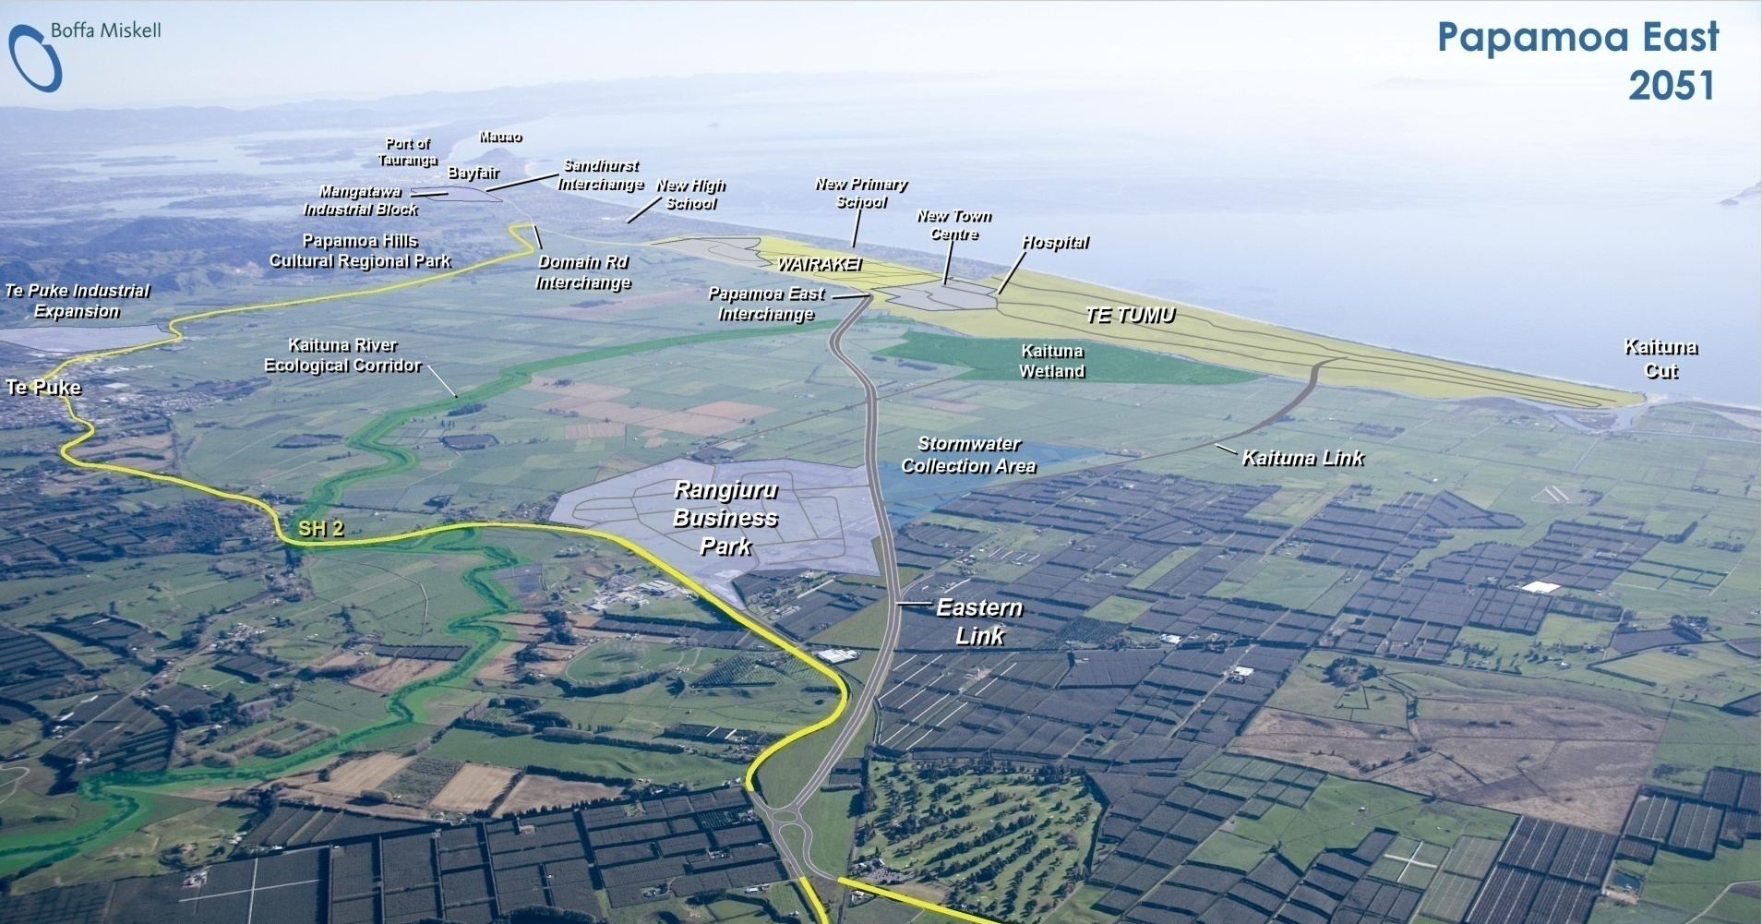
Te Tumu Development Update

Slide 32
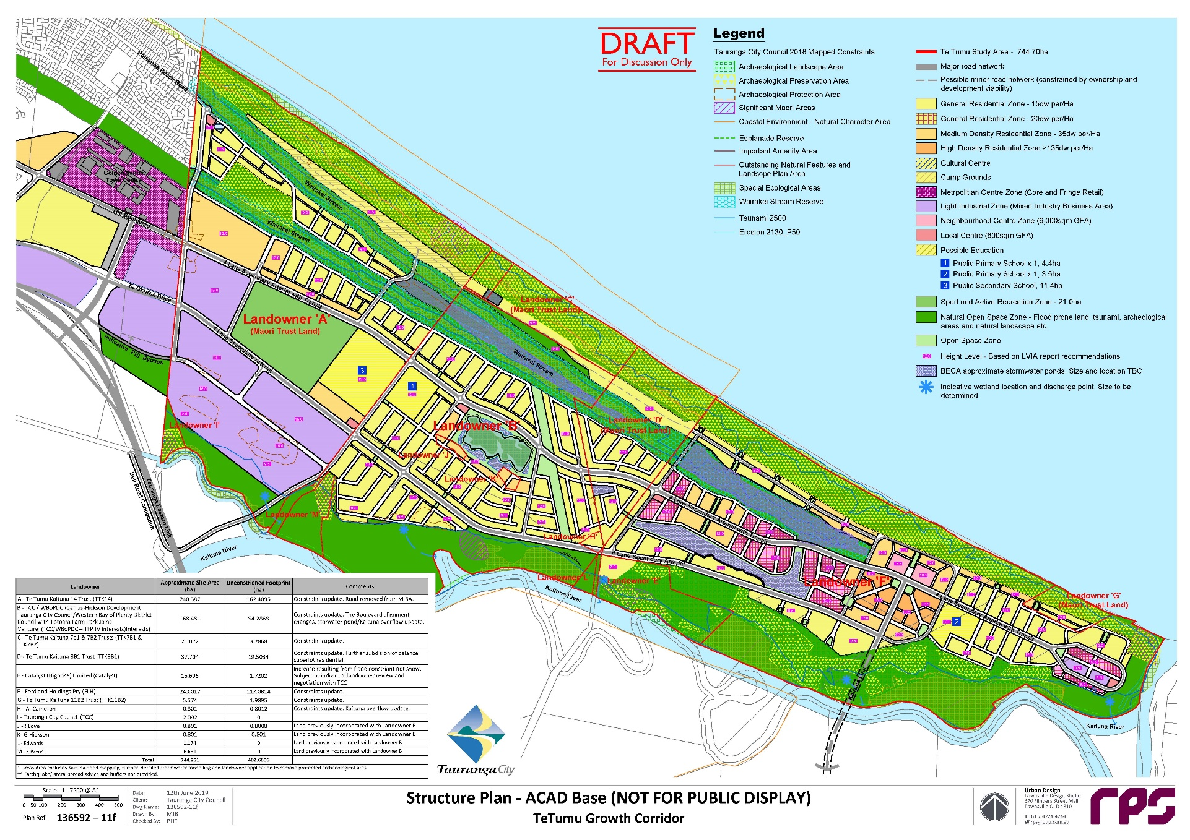

Te Tumu Draft Structure Plan

Slide 33
Te Tumu Plan Change & Structure Plan
Finalised Workstreams:
Land Constraints Identification & Mapping
High Level Urban Land Use Spatial Planning
Natural Hazards
4. Stormwater Strategy; modelling, design strategy & land-use optimisation
Transportation & Infrastructure Corridors; based on Multi-Model, Road Corridor Design.
Landscape and Visual Assessments.
Workstreams to be finalised:
Tangata Whenua Consultation.
NPSFM Wetland Identification and Consenting Pathways.
Infrastructure Planning; centred on Water & Wastewater.
Planning Rules.
Open Space Planning and Management.
Development Contributions and Infrastructure Costings.
Notes:
.

Slide 34
Surrounding Development
Papamoa East Interchange (PEI): Due to commence in 2022 (subject to funding); completion in 2025.
The Sands Town Centre: Commencement of first stage 2022/23 based on PEI commencement. To see more on this substantial development directly adjacent to TK14 go to https://www.youtube.com/watch?v=uTnFT2vRdNw
Rangiuru Business Park: Earthworks for Interchange and Subdivision commenced late 2021.
Papamoa East Interchange

Slide 35
TK14 Funding Opportunities
There have been significant government initiatives recently introduced to support and enable Māori-led housing solutions. These iniatives are centred on Whai Kāinga Whai Oranga,the $730m fund can provide investment for:
Increasing organisational capability and capacity to deliver Māori-led housing solutions.
Delivery of new or upgraded infrastructure to increase the supply of build ready land.
Housing project that increase the supply of housing provided by Māori.
There is the opportunity for up to 1,500 (approx) residential dwellings on the TK14 land.
The Trustees have prepared and have lodged an Expression of Interest Application with Te Puni Kōkiri to fund a detailed business case and feasibility for housing on the TK14 land and provide infrastructure for the housing.
Notes:
Refer to blog post detail sheet dated 22 January 2022 for details for each guiding principle.

Slide 36
Other Funding Opportunities
Other Funding opportunities include:
Progressive Home Ownership Funding via Te Au Taketake, the Iwi and Māori pathway.
Infrastructure Acceleration Fund (TCC applications).
Housing Infrastructure Fund (TCC application).
The feasibiliity funding will provide greater certainty regarding infrastructure and land uses, and allow further applications for funding to be made.
The high-level infrastructure costs to fully develop TK14 lands are $80m (approx), the Trustees acknowledge that these costs will need to be funded by a range of funding sources and opportunities.

Slide 37
Planning Timeline
The current projected Planning Timeline is:
2022: TK14 owner and owner participation hui and feedback.
2022: TK14 Māori Land Court applications subject to owner approval.
2022 (late): Te Tumu Plan Change Lodged and Notified (by TCC).
2022 – 2024: Plan Change Process.
2025 – 2026: Commence Development.

Slide 38
Te Tumu Development Update
Questions & Answers from Hui #1:
  Q1: Why does the Trust needs to be involved now and could instead wait for development to occur around them?
  A1: The Trustees believe it is in the best interests of the Trust and its owners to be actively involved now to ensure that the best outcomes are secured for the future of the Trust with regard to enabling the Trustee Guiding Principles to be achieved. The development is happening next to the Trust land, and the Trustees consider that this presents owners with a unique opportunity to create leverage and best outcomes for the future.
  The alternative access (avoiding Trust land) is being considered, by way of a bridge over the river, but this option appears to be non-feasible.

Slide 39
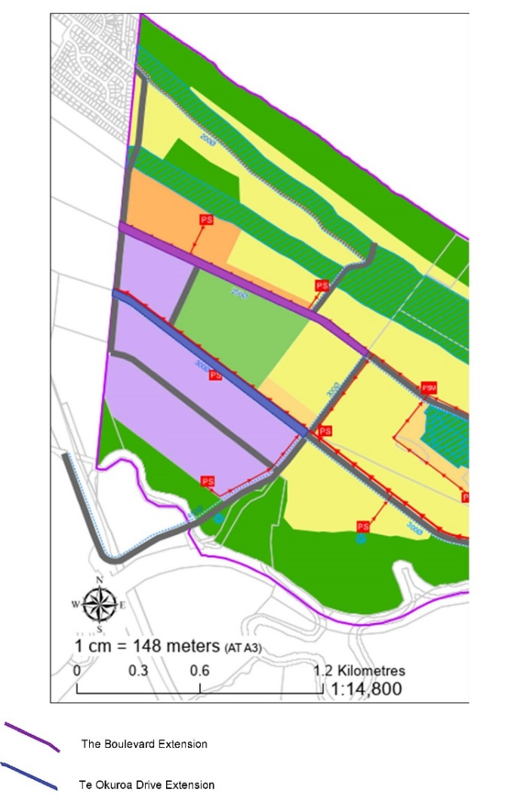
Infrastructure Corridors & Active Reserve Options & Process
The Boulevard (Purple)
38m wide x 1350m total length (approx.) = 51,300m (5.13ha) approx.
Note: this does not include intersections. With intersections (at approx. 45m width) total area for corridor is approx. 5.45ha.
Extension of Te Okuroa Drive (Blue)
37m wide x 1160m total length (approx.) = 42,920m (4.29ha) approx..
Note: this does not include intersections. With intersections (at approx. 45m width) total area for corridor is approx. 4.50ha.
Active Reserve (Red Circle)
20 ha Active Reserve.

Slide 40
Infrastructure Corridors & Active Reserve|TK14 Benefits
The benefits of the infrastructure corridors and Active Reserve to TK14 include:
Enabling the Te Tumu Plan Change and in turn the Trustee Guiding Principles.
Provides required infrastructure to TK14 for housing and commercial development.
Links TK14 to the wider transport network.
Enables Government Funding opportunities to be realised ie Whai Kāinga Whai Oranga.
Provision of Income Streams through long term land leases.

Slide 41
Infrastructure Corridors & Active Reserve| Options
The options identified for infrastructure corridors and Active Reserve are:
TCC interest in these land areas is enabled by easements and compensated for by transfer of TCC surplus land titles to TK14 (adjacent to TK14 boundary).
Land exchange; land areas are exchanged for TCC surplus land titles to TK14 (adjacent to TK14 boundary).
Interest in the land areas enabled by easements and financial compensation.
Māori Roadways over infrastructure corridors.
Long Term Lease >52 years as carried out at Mangatawa Papamoa ie conversion of land to General Title registration of Long Term lease then convert land back to Māori Freehold Title.
Long Term Lease >52 years.
Covenant in favour of TCC over infrastructure corridors.

Slide 42
Infrastructure Corridors & Active Reserve|High Level Assessment
Options | Pros /Cons
1. TCC Interest in these land areas is enabled by easements and compensated for by transfer of TCC surplus land titles to TK14. | Enables TK14 retention of land for infrastructure corridors and an increase in TK14 lands to the west. Operational considerations to be worked through.
2. Land exchange; land areas are exchanged for TCC surplus land titles to TK14. | TK14 doesn’t retain the land for infrastructure corridors; however may be able to acquire additional surplus land.
3. Interest in the land areas is enabled by easements and financial compensation | Enables TK14 retention of land for infrastructure corridors for financial compensation. Has operational considerations / risks.
4. Māori Roadways over infrastructure corridors. | Enables TK14 retention of land for infrastructure corridors for financial compensation. Infrastructure security of tenure maybe an issue to infrastructure providers.
5. Long Term Lease >52 years as carried out at Mangatawa Papamoa. | ie conversion of land to General Title registration of Long Term lease then convert land back to Māori Freehold Title. Requires broad owner support and Māori Land Court approval.
6. Long Term Lease >52 years | Enables TK14 retention of land for infrastructure corridors for financial compensation. Difficult to satisfy the threshold for owner support requirements.
7. Covenant in favour of TCC over infrastructure corridors | Enables TK14 retention of land for infrastructure corridors for financial compensation. Infrastructure security of tenure maybe an issue to infrastructure providers.

Slide 43
Infrastructure Corridors & Active Reserve| Process
The process for progressing the infrastructure corridors and active reserve is:
Engage with, inform and obtain Beneficial Owner feedback.
Prepare formal resolutions based on Beneficial Owner feedback.
Beneficial Owners’ vote on resolutions.
Based on Beneficial Owner voting preference prepare applications to the Māori Land Court.

Slide 44
Infrastructure Corridors & Active Reserve| Process
Questions & Answers from Hui #1:
  Q1: Will the exchange of land (interests) be in favour of the owners?
  A1: If this is the preferred option the Trustees are committed to negotiating the best outcome for owners.
  Q2: Will any exchange land be held as General Land or Māori Freehold Land.
  A2: The law requires exchange land to be held as Māori Freehold Land, however there are exceptions. Feedback from owners is sought on this.

Slide 45
Next Steps
The next steps are:
Post this presentation on the TK14 website.
Seek owner input / feedback via the TK14 website, facebook page or directly to the Trustees on the:
Trustee Guiding Principles.
Trustee Rotation and Elections.
Infrastructure Corridor and Active Reserve options.
Engage with, inform and obtain Beneficial Owner feedback.
Seek direct owner participation in proposed upcoming engagement hui.
Summarise outcomes from engagement hui.
Prepare formal resolutions based on Beneficial Owner feedback.
Beneficial Owners’ vote on resolutions via postal vote.
Based on Beneficial Owner voting preference prepare applications to the Māori Land Court.

