Slide 1

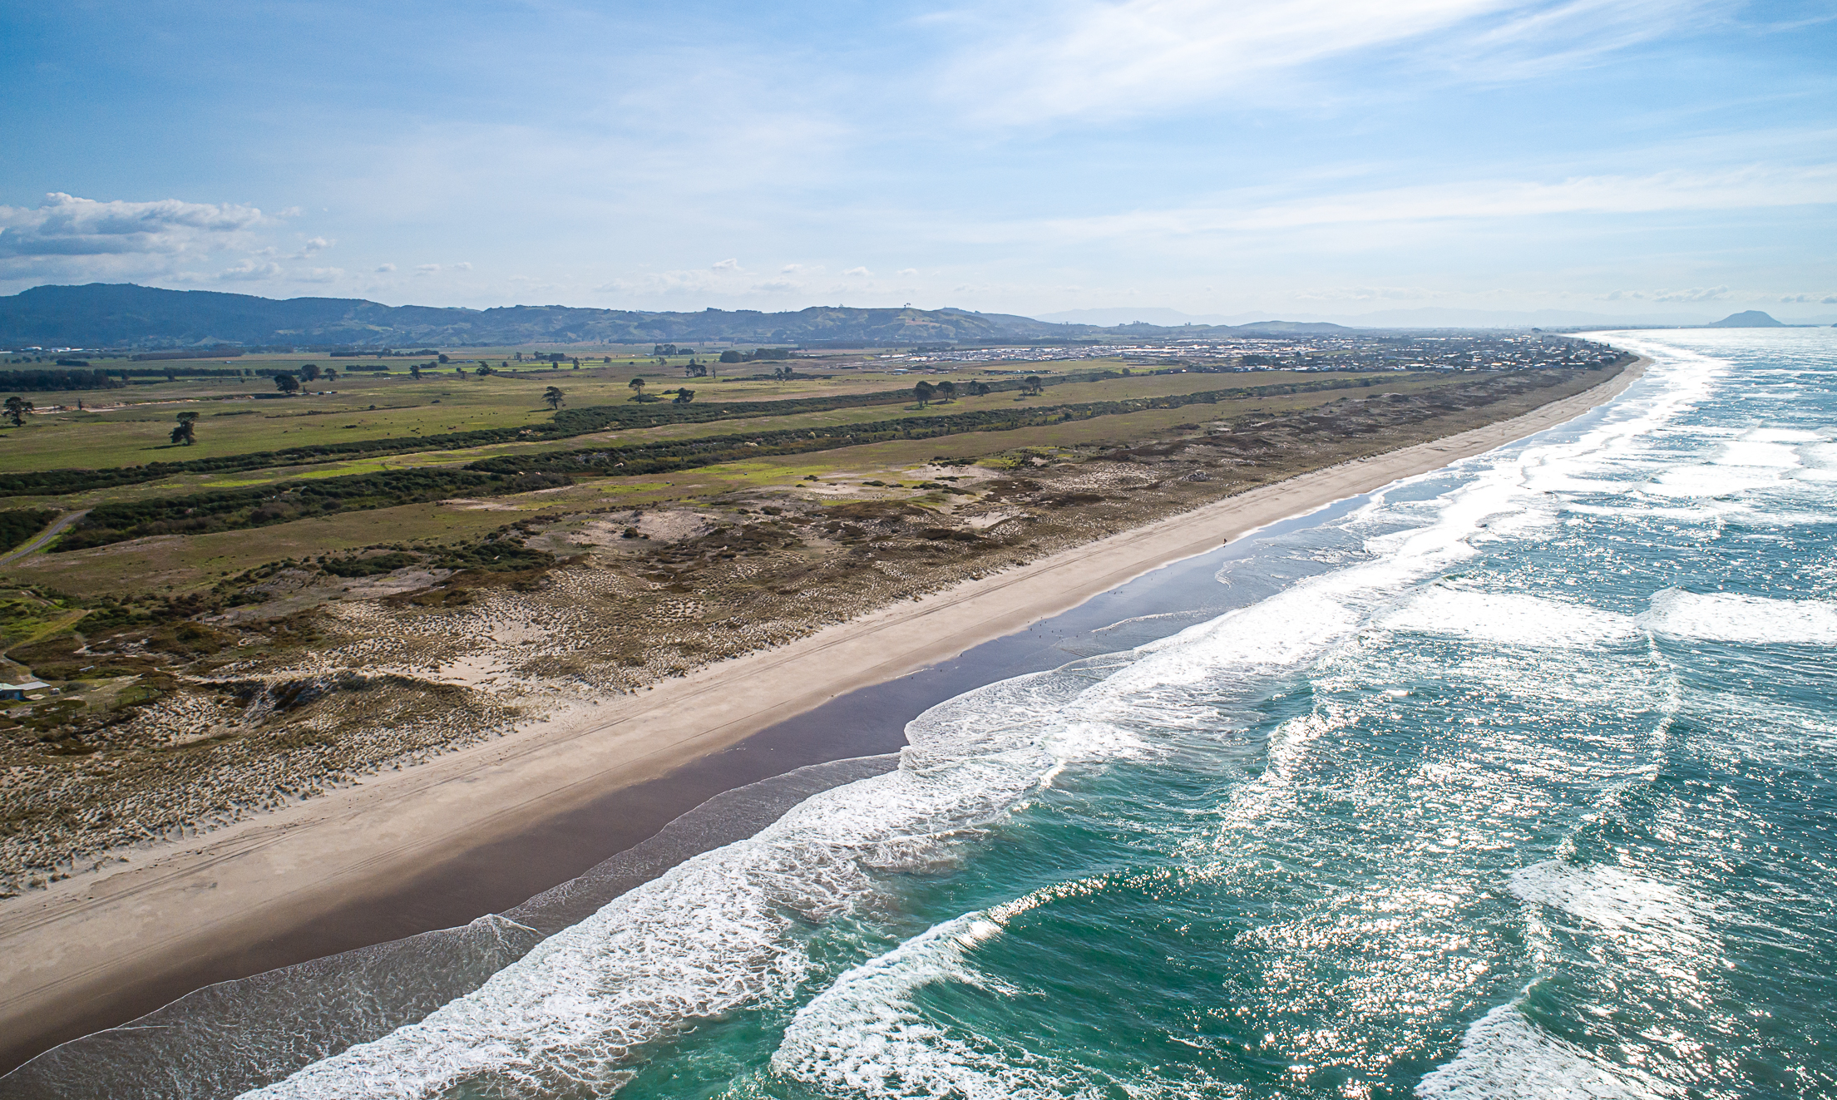
Tumu Kaituna 14 Trust
2 April 2022 | Engagement Hui No #3

Slide 2
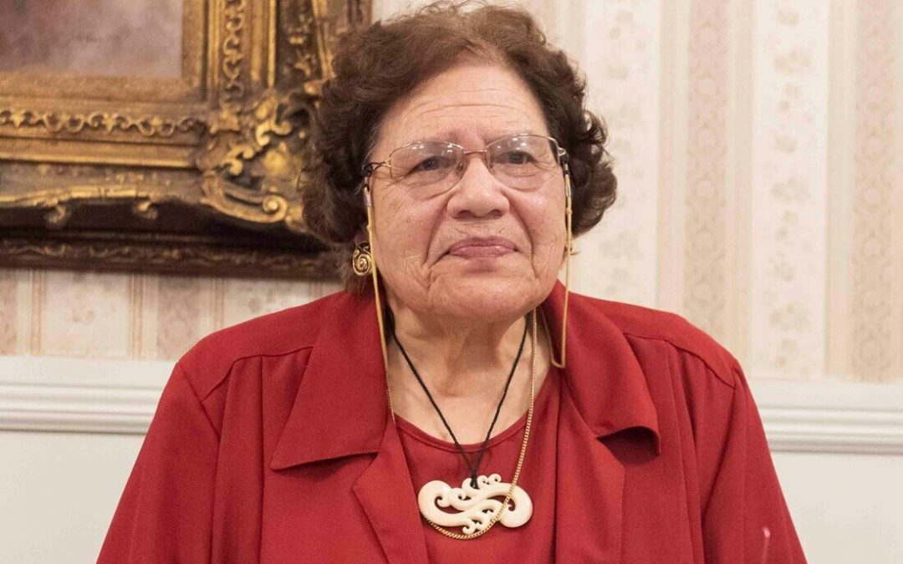
Pirihira Fenwick
In Memoriam
Mihi Poroporoaki
Notes:
Waldo to speak

Slide 3
Preliminaries / House Keeping
Karakia
Introduction of Facilitator, Trustees and Support Team
Owners must register – Amber Taare will message if details are required.
If in a group please provide participants’ details.
Hui Protocols: Hui will be recorded and made available on the website to owners. This presentation will also be posted on the website.
Please note that Covid is impacting resourcing and responses to questions.
Webinar style via Zoom: How to participate by asking questions or giving feedback or giving apologies? Use the Q&A function;

Slide 4

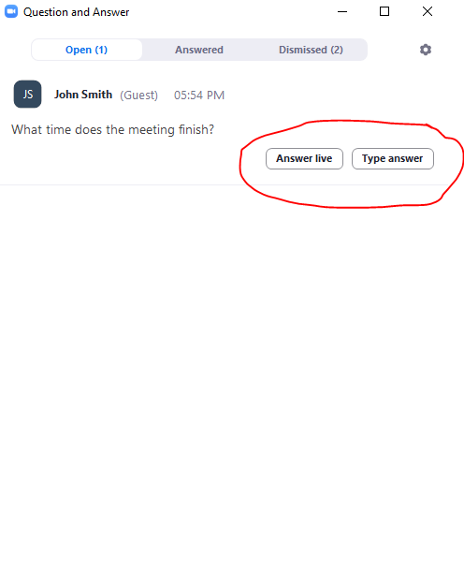
Asking questions or providing feedback

Slide 5
Hui Agenda
Mihi, Karakia and Preliminaries
Cultural and Historical Background
Previous Presentations – available online
Trustee Rotation and Elections – amended proposals
Housing Proposals
Development costs update
Te Tumu Development Land Exchange
Rates update
Process for Voting on Resolutions and Online Survey
Next Steps.

Slide 6
Engagement Hui Process & Purpose
Four Engagement Hui are planned to provide Beneficial Owners the opportunity to consider and provide feedback and input on (1) Proposed Trustee Rotation and Election Policy and (2) Options for development of Trust lands (3) Infrastructure Corridor Options through the Trust lands.
Hui #1 – 13 Feb 2022 (Presentation of Trust information and options). Complete.
Hui #2 – 26 Feb 2022 (Presentation of Trust info and options; Q&A responses from Hui #1).
Hui #3 – 2 April 2022 (Today, further detail on Housing, Elections, Land Exchange Options).
Hui #4 – 30 April 2022 (Venue and details TBC).
Engagement Hui timing and format is being developed based on Covid restrictions and owner feedback to provide for maximum owner participation.
As the Engagement Hui are held, resolutions will be developed with feedback, leading to a Postal Vote on formal resolutions.
TK14 website is being regularly updated with information and feedback.

Slide 7
TE TUMU KAITUNA 14
TE TUKUNGA IHO
Notes:
Uenuku is reducing slides by one third

Slide 8
TE ŪNGA MAI ME TE WHAKANOHONOHO
1350 – 1500
It is generally believed that Te Arawa canoe arrived about 1350.
For the next five generations Te Arawa had settled the area from Mauao to beyond Pukehina, and the inland country to Rotorua.
Gradually the people of Te Rangihouhiri – Ngāi Te Rangi – moved into the area. A series of skirmishes resulted in the battle of Pōporohuamea, and Maketū and the surrounding area was taken.
Not long after Mauao and other parts of Tauranga were taken from Waitaha by Ngāi Te Rangi at the battle of Te Kōkōwai.

Slide 9
TE HOKINGA ATU
1500 – 1835
Waitaha and Tapuika remained settles around their respective mountains of Ōtawa and Rangiuru maintaining an uneasy peace with Ngāi Te Rangi.
Gradually the inland Te Arawa based around Rotorua returned to the area as allies and relations of Waitaha and Tapuika, some even settling at Maketū.
Inland wars between Te Arawa and Tainui spilt over to the coast, wherby Te Waharoa of Ngāti Hauā sacked Maketū, killing Te Ngahuru, an important chief of Ngāti Whakaue.

Slide 10
TE PAKANGA
23 April 1836
Kahawai of Ngāti Rangiwewehi grew impatient for revenge and went to Ōtawa to await the rest of Te Arawa to organize themselves.
When the rest of the inland Te Arawa and their allies from Waitaha, Tapuika and elsewhere, they attacked the pā at Te Tumu and took it.
Ngāi Te Rangi were defeated and pursued to the mouth of Te Wairākei Stream at Papamoa.
Small resultant skirmishes did not change the new boundary between Te Arawa and Ngāi Te Rangi.

Slide 11
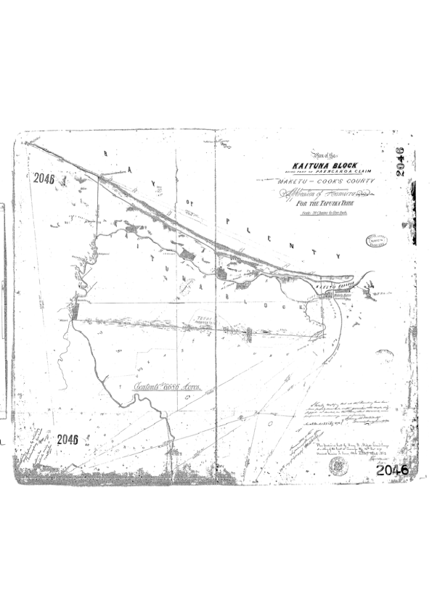
TE KOOTI WHENUA MĀORI 1
Ōtumumatawhero
Te Kōpua
Te Karaka
Te Pāroa
Te Tumu
Te Kakari
Papahīkahawai

Slide 12
NGĀ WHAKAWĀKANGA KOOTI
2 May 1883
Te Tumu Kaituna was awarded by the Native Land Court to Ngāti Tūnohopū and Ngāti Whakaue, as well as Ngāti Rangiwewehi, Ngāti Uenukukōpako and Ngāti Rangiteaorere.
The witnesses for the last three iwi were respectively Hōri Te Rahoatua, Tāmati Hapimana and Te Kiri Karamu.
Each of the hapū put in a few people from other iwi through aroha.

Slide 13
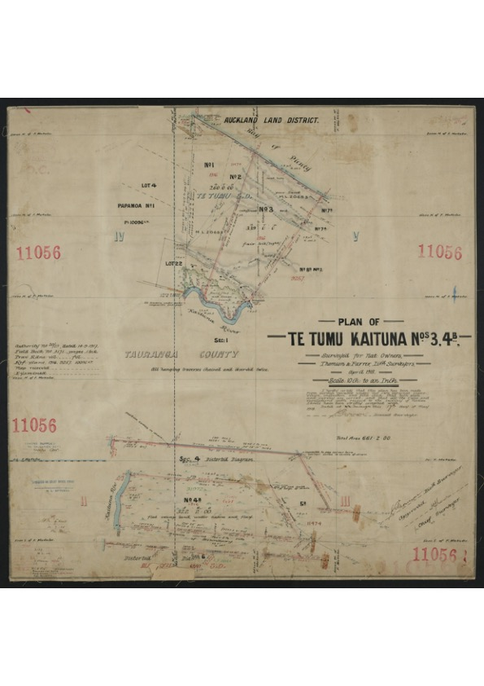
TE KOOTI WHENUA MĀORI 2
PARTITIONS
TK1 to N’Uenukukōpako 156a
TK2 to N’ Rangiteaorere 101a
TK3 to N’Rangiwewehi 333a
TK4 to N’Rangiwewehi 751a
TK5 to N’Rangiteaorere 226a
TK6 to N’Uenukukōpako 353

Slide 14
TE KOTIKOTI WHENUA
28 Aug 1890
Te Tumu Kaituna was partitioned into 13 blocks, of which Blocks 3 & 4 were awarded to Ngāti Rangiwewehi, 1 & 6 to Ngāti Uenukukōpako and 2 & 5 to Ngāti Rangiteaorere.
The witnesses for the three iwi were respectively Hōri Te Rahoatua, Tāmati Hapimana and Hēmi Kōkiri.
Eventually Blocks 4, 5 & 6, were sold to the Crown. That was 1330 out of a total of 1920 acres, or nearly 70% of the land.
Blocks 1, 2 & 3 were further partitioned, but eventually amalgamated in 19__ as Te Tumu Kaituna 14, except for a small partition of Block 1 that had already been sold.

Slide 15
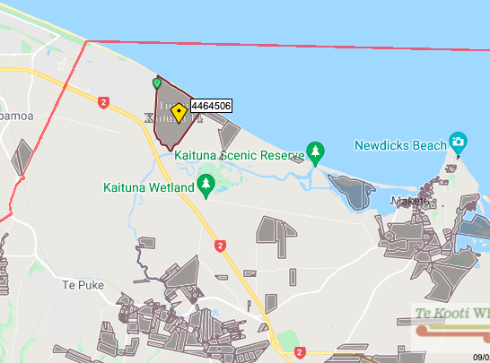
TE ROHE 2022

Slide 16
Trustee Guiding Principles for TK14
Trustee Guiding Principles to inform the proposed development opportunities for our Whenua:
Developing the land without selling it.
Ensuring our history and cultural connection is represented and respected.
Houses for our people.
Community spaces and places for beneficial owners.
Commercial opportunities for beneficial owners.
Employment, education and training opportunities for beneficial owners.
Creation of sustainable income for beneficial owners.
Each principle has been detailed in previous hui, and we invite owner feedback and engagement through this hui process.

Slide 17
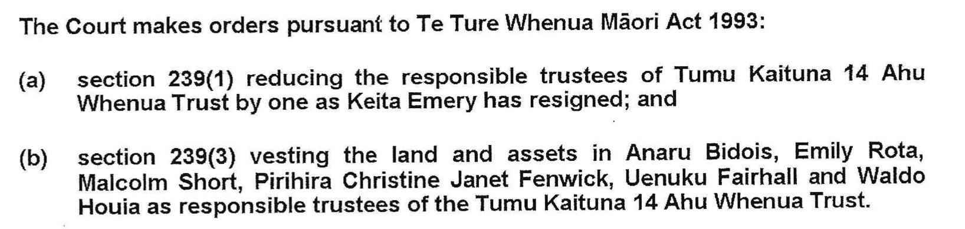
Trustee Rotation and Elections:
There are currently six trustee positions for TK14 Trust.
There is currently an owner dispute as to whether an election should have occured for a seventh position: that dispute is in front of the Chief Judge for review. TK14 Trust does agree that the optimum number of trustees is 7, but the Trust is NOT currently in breach.
Order of MLC 1 March 2018:

Slide 18
Trustee Elections
With the sad passing of Pirihira Fenwick and following feedback received from Hui Nos 1&2,
the Trustees seek feedback on an amended Trustee Elections and Rotation proposal:
An Election held within the next four months for two new Trustees to bring the total number of trustees to seven.
An additional and separate process to allow for Trustee Rotation and Elections. (This requires sufficient owner support to a variation to the Trust Order, to be filed with the MLC after this engagement process, and could be in place by early 2023).

Slide 19
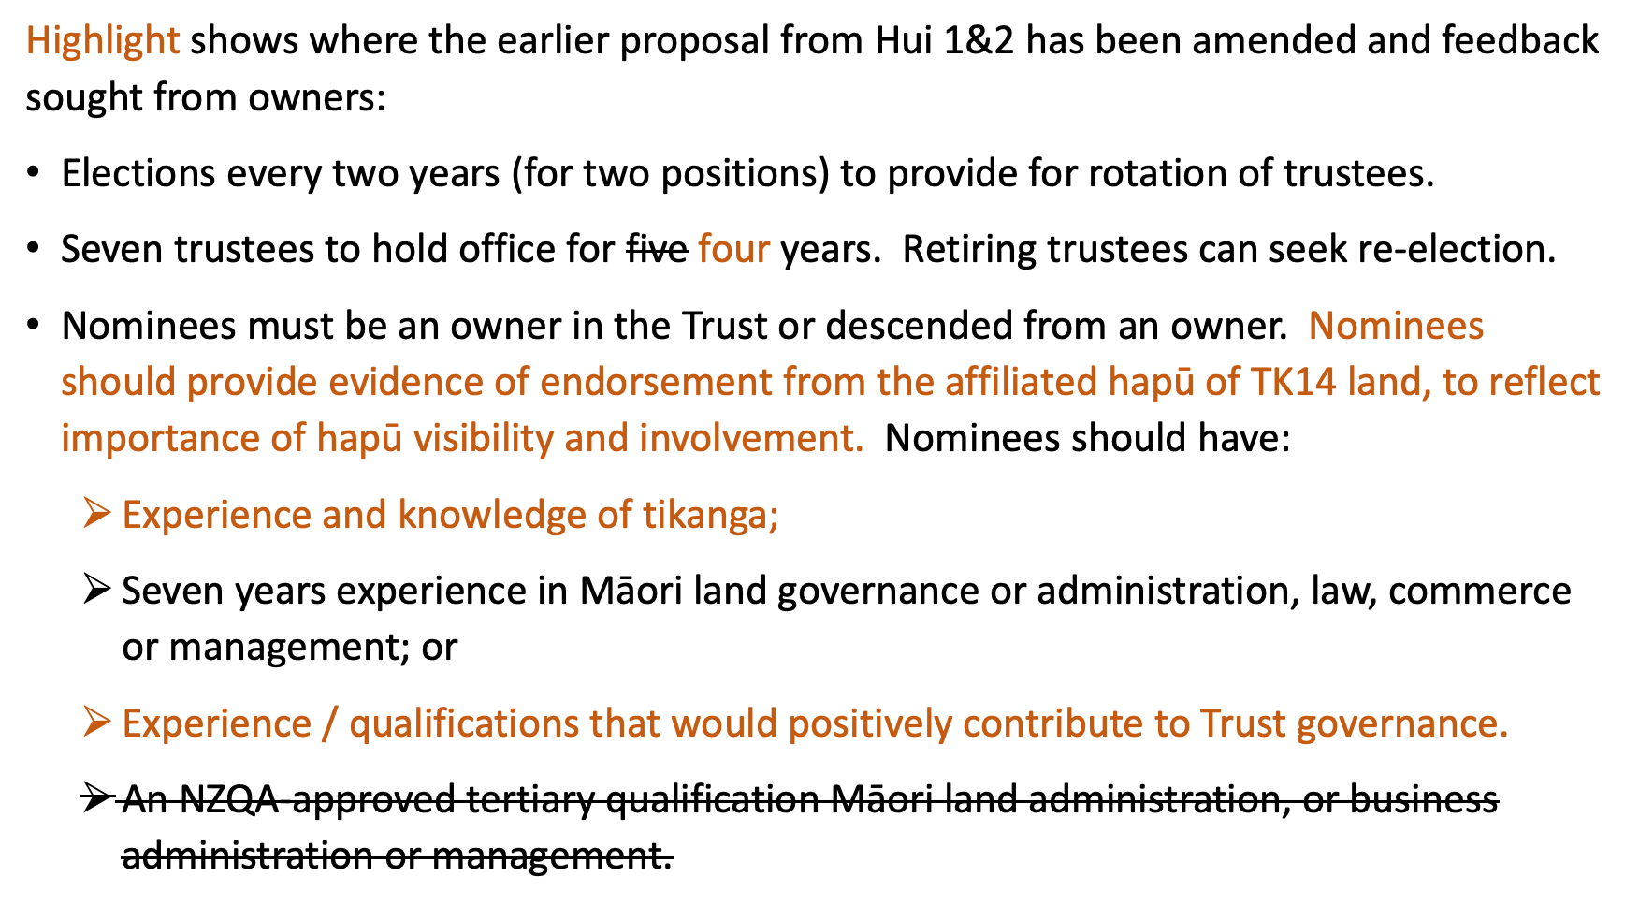
Amended Proposal: Trustee Rotation

Slide 20
Proposal for Trustee Elections and Rotation :
Owner feedback is sought on the Trustee Elections and Rotation proposal to progress:
A draft proposal to be prepared.
Voting on the proposal to be arranged.
Based on the voting outcome (broad support of owners required) a Trust Order Variation be prepared and lodged with the Māori Land Court .

Slide 21
Housing for Owners:
Expanding on Principle 3: Houses for our people (as above); the Trust has engaged the services of Martin Udale from Essentia Consulting Group to provide further information on the housing initiatives that can provide a range of housing opportunities for owners.
Martin is assisting the Trust with the applications to Whai Kāinga Whai Oranga, the $730m fund to provide to support and enable Māori-led housing solutions.
The TK14 Whai Kāinga Whai Oranga Expression of Interest Application lodged with Te Puni Kōkiri is to fund a detailed business case and feasibility for housing on the TK14 land and in turn to provide support for funding of infrastructure and housing.
A key part of the feasibility for housing will include engagement with TK14 owners to understand their housing aspirations and needs.
How the housing options could apply to a range of owners is detailed on the following slide.

Slide 22
Housing Continuum….its about
Housing for Owners:
The right housing solution, for the right need at the right time……
Providing pathways from one tenure to another
Emergency Housing
Social Housing
Assisted Rental
Assisted Ownership
Private Rental
Private Ownership
Increasing support
Decreasing support

Slide 23
Housing for Owners:
The table below provides fictional examples of how the housing options identified by the Trustees could apply to a range of owners.
No | Owner (fictional) Case Study Example | Housing Options | Potential External Funding Sources
1 | 70 year old owner; wanting unit in a community of elderly residents. Unit to pass on to daughter. | Licence to Occupy (for land) in a Kaumatua Village concept based on house ownership able to be transferred to nominated whanau beneficiary. | Whai Kāinga Whai Oranga funding for Māori Led Housing Initiatives. Kāinga Ora Build Own Operate Model for infrastructure (provision made for owner allocations). Kāinga Ora First Home Partner scheme for funding of home. Also referred to as Progressive Home Ownership. Shared Ownership and Rent to Own programmes from NZ Housing Foundation for funding of home. Traditional Bank Financing.
2 | Young Couple owners with two tamariki; wanting to build or purchase a home to live in with ability to build up and realise equity in the home so they can sell and move in the future. | Licence to Occupy (for land) house ownership in an owner mixed density subdivision (mixture of detached and attached (duplexes, terraces & townhouses), in which the house / dwelling able to be sold in the future (minimum initial tenure required).
3 | Middle Aged Couple; empty nesters wanting to build or purchase a home; have a higher budget. | As above for a larger house / dwelling.
4 | Young (twenty-something) owner looking for affordable rental and possible rent to buy option in the future. | Community Hosing Trust (CHT); either fully Trust owned and operated or a JV with an established CHT. Ability to transfer / transition to a rent to buy option in the future. | Whai Kāinga Whai Oranga funding for Māori Led Housing Initiatives. Kāinga Ora Build Own Operate Model for infrastructure (provision made for owner allocations). Accommodation Supplement - MSD MSD IRRS/capacity contracts for long term public housing outcomes
5 | Owner on a disability pension needing affordable rental housing with security of tenure. | Community Hosing Trust (CHT); either fully Trust owned and operated or a JV with an established CHT.
6 | Elderly owner wanting an affordable unit in a community of elderly residents. | Kaumatua Village / Papakāinga concept with houses and land owned by a Trust managed housing entity. Trust rental subsidies to be explored. | Whai Kāinga Whai Oranga funding for Māori Led Housing Initiatives. Te Puni Kōkiri Papakāinga funding grants and support
7 | Owner moving to Pāpāmoa for work with no support or savings; looking for subsidised housing so they can work in the area and save to transition into more permanent housing. | Transitional Housing; subsidised by Kāinga Ora. | Whai Kāinga Whai Oranga funding for Māori Led Housing Initiatives. Kāinga Ora Transitional Housing Iniatiative.

Slide 24
Housing for Owners:
Identified Options Background:
Build Own Operate Transfer Model – Kāinga Ora (KO) build, own and operate affordable rental properties that cater for beneficial owners and the wider community on leasehold land, which is returned after a period of up to 25 years.
KO would be interested to explore a range of housing provision including social housing, affordable rental, shared equity/progressive home ownership schemes
Possible structres include a BOOT type arrangment, a Joint Venture or similar – based around long term reversion to TK14 and underlying ownership of land remaining with TK14
”The numbers would need to make sense”

Slide 25
Housing for Owners:
Build to Own Housing – This would likely be on a shared equity basis guaranteed by Kāinga Ora and the Tumu Kaituna 14 Trust and provided for through the Progressive Home Ownership Fund.
Examples include
  NZ Housing Foundation
  Manawa PHO Limited (Nga Potiki a Tamaphore Trust housing arm)
  Tamaki Regeneration – Shared Home Ownership Scheme
Potential Funding to support a PHO scheme available through Hud PHO Fund - Te Au Taketake is the pathway for Iwi and Māori organisations to access the Progressive Home Ownership Fund.
Could also provide for owners to own a home on TK14 leasehold land – models exist, mortgage funding available via main banks (Westpac)
Rent to own and other variants are also possible - NZ Housing Foundation example

Slide 26
Housing for Owners:
Community Housing – Establishing community housing development through a provider and our trust that would specifically cater to providing social and affordable rental accommodation for our owners and their whānau.
Comments for discussion:
Trust could setup their own CHO to build and own quality housing stock to provide subsidised social or affordable (60%-&70% of market) rental homes for families:
Locally Nga Potiki have successfully established the Manawa Community Housing Trust to do this.
Tamaki Regeneration established the Tamaki Housing Association.
A wide range of CHO’s throughout NZ that provide a range of Community Housing models.
Notes:
Refer to blog post detail sheet dated 22 January 2022 for details for each guiding principle.

Slide 27
Housing for Owners:
Transitional housing for our people without stable accommodation.
Comments for Discussion
KO are interested in partnering on this and are willing to provide the houses (preferably relocatable) which return to the Trust after an initial term of 5-10 years.
Enables affordable housing to be moved around the TK14 as the block is developed.
May contribute towards infrastructure development for permanent housing after transitional housing moved.
A pathway to a permanent home whether leased or owned.
Notes:
Refer to blog post detail sheet dated 22 January 2022 for details for each guiding principle.

Slide 28
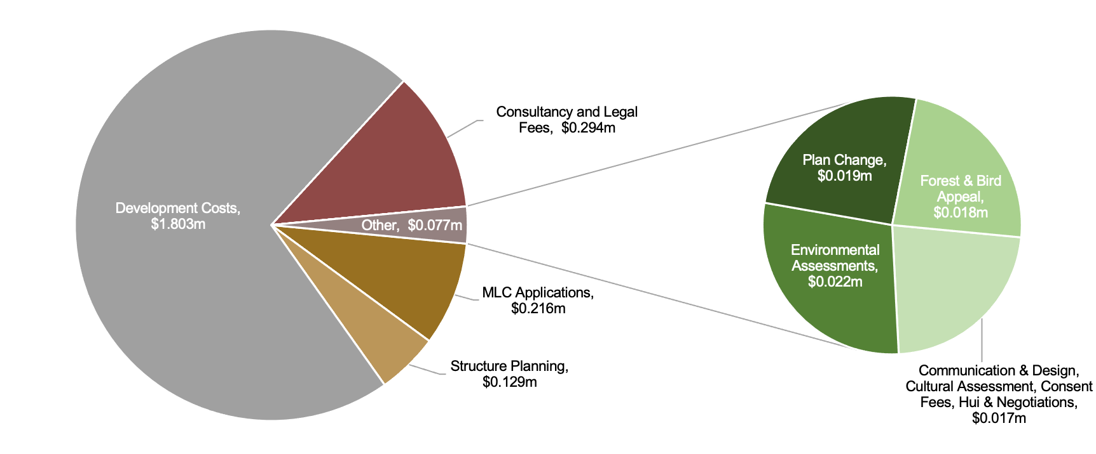
To Date Development Costs

Slide 29
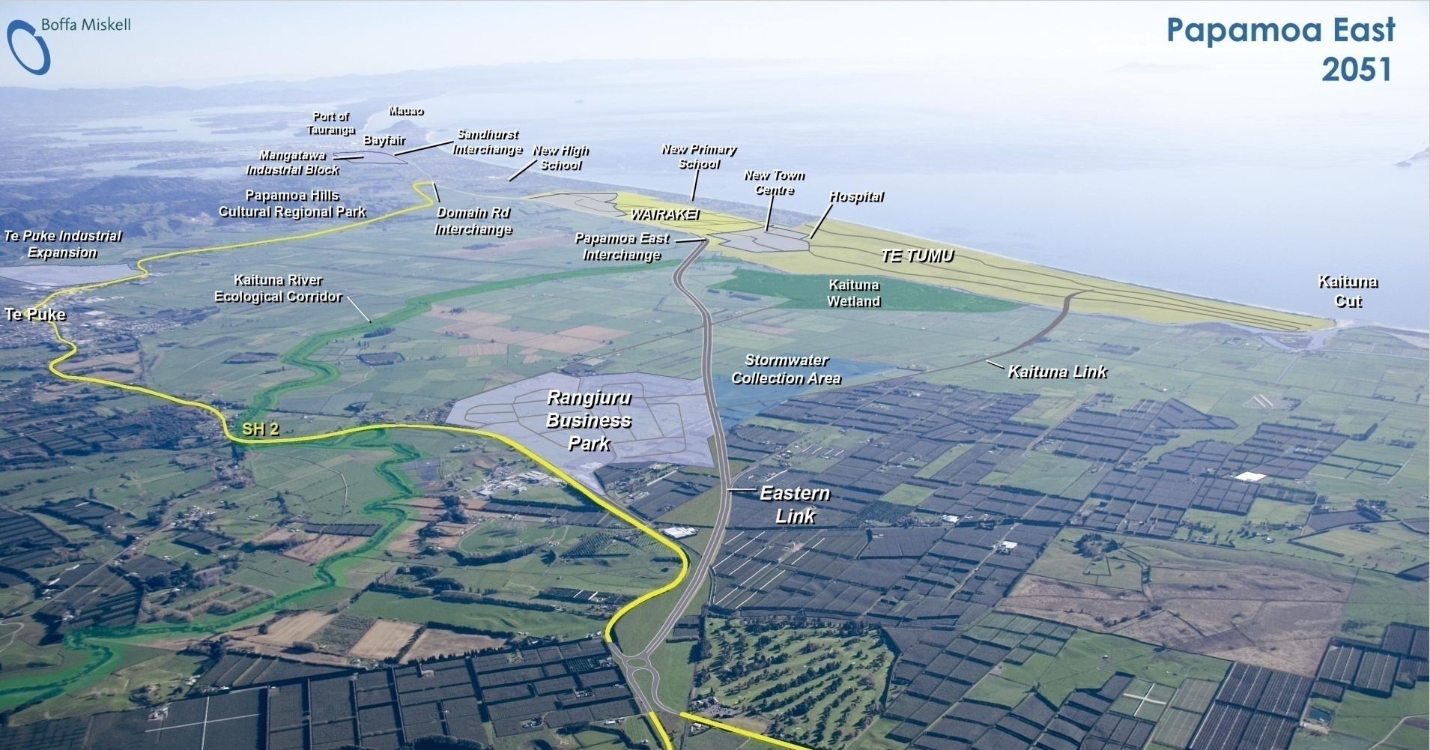
Te Tumu Development Update

Slide 30
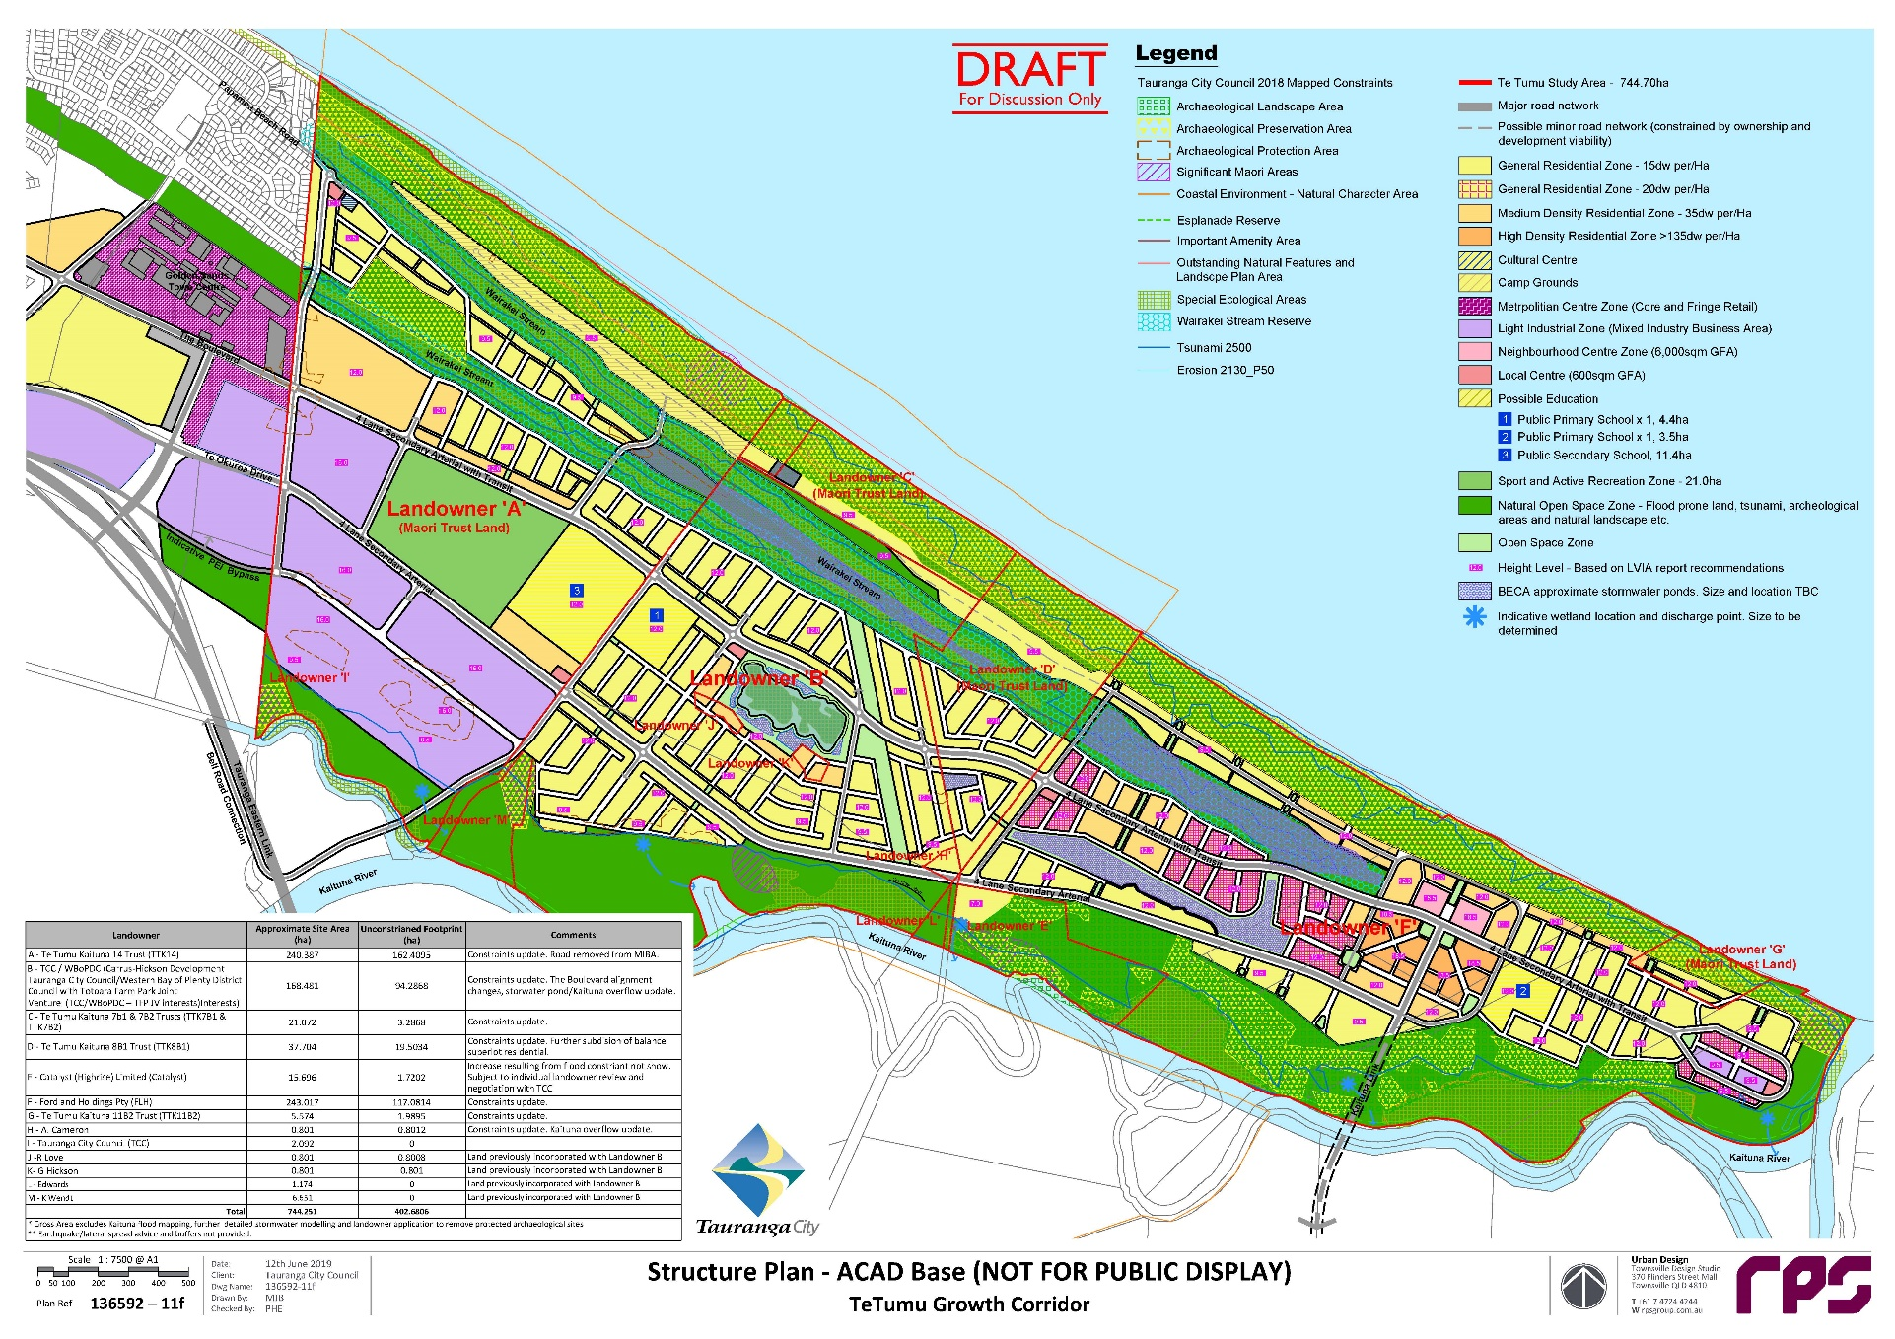

Te Tumu Draft Structure Plan

Slide 31
Surrounding Development
Papamoa East Interchange (PEI): Due to commence in 2022 (subject to funding); completion in 2025.
The Sands Town Centre: Commencement of first stage 2022/23 based on PEI commencement. To see more on this substantial development directly adjacent to TK14 go to https://www.youtube.com/watch?v=uTnFT2vRdNw
Rangiuru Business Park: Earthworks for Interchange and Subdivision commenced late 2021.
Papamoa East Interchange

Slide 32
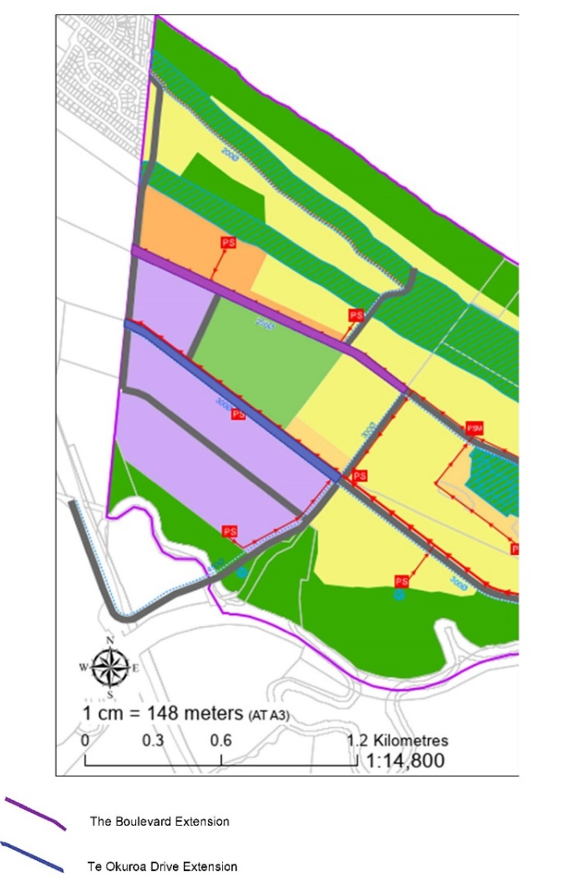
Infrastructure Corridors & Active Reserve Options & Process
The Boulevard (Purple)
38m wide x 1350m total length (approx.) = 51,300m (5.13ha) approx.
Note: this does not include intersections. With intersections (at approx. 45m width) total area for corridor is approx. 5.45ha.
Extension of Te Okuroa Drive (Blue)
37m wide x 1160m total length (approx.) = 42,920m (4.29ha) approx..
Note: this does not include intersections. With intersections (at approx. 45m width) total area for corridor is approx. 4.50ha.
Active Reserve (Red Circle)
20 ha Active Reserve.

Slide 33
Infrastructure Corridors & Active Reserve|TK14 Benefits
The benefits of the infrastructure corridors and Active Reserve to TK14 include:
Enabling the Te Tumu Plan Change and in turn the Trustee Guiding Principles.
Provides required infrastructure to TK14 for housing and commercial development.
Links TK14 to the wider transport network.
Enables Government Funding opportunities to be realised ie Whai Kāinga Whai Oranga.
Provision of Income Streams through long term land leases.

Slide 34
Infrastructure Corridors & Active Reserve| Options
The options identified for infrastructure corridors and Active Reserve are:
TCC interest in these land areas is enabled by easements and compensated for by transfer of TCC surplus land titles to TK14 (adjacent to TK14 boundary).
Land exchange; land areas are exchanged for TCC surplus land titles to TK14 (adjacent to TK14 boundary).
Interest in the land areas enabled by easements and financial compensation.
Māori Roadways over infrastructure corridors.
Long Term Lease >52 years as carried out at Mangatawa Papamoa ie conversion of land to General Title registration of Long Term lease then convert land back to Māori Freehold Title.
Long Term Lease >52 years.
Covenant in favour of TCC over infrastructure corridors.

Slide 35
Infrastructure Corridors & Active Reserve|High Level Assessment
Options | Pros /Cons
1. TCC Interest in these land areas is enabled by easements and compensated for by transfer of TCC surplus land titles to TK14. | Enables TK14 retention of land for infrastructure corridors and an increase in TK14 lands to the west. Operational considerations to be worked through.
2. Land exchange; land areas are exchanged for TCC surplus land titles to TK14. | TK14 doesn’t retain the land for infrastructure corridors; however may be able to acquire additional surplus land.
3. Interest in the land areas is enabled by easements and financial compensation | Enables TK14 retention of land for infrastructure corridors for financial compensation. Has operational considerations / risks.
4. Māori Roadways over infrastructure corridors. | Enables TK14 retention of land for infrastructure corridors for financial compensation. Infrastructure security of tenure maybe an issue to infrastructure providers.
5. Long Term Lease >52 years as carried out at Mangatawa Papamoa. | ie conversion of land to General Title registration of Long Term lease then convert land back to Māori Freehold Title. Requires broad owner support and Māori Land Court approval.
6. Long Term Lease >52 years | Enables TK14 retention of land for infrastructure corridors for financial compensation. Difficult to satisfy the threshold for owner support requirements.
7. Covenant in favour of TCC over infrastructure corridors | Enables TK14 retention of land for infrastructure corridors for financial compensation. Infrastructure security of tenure maybe an issue to infrastructure providers.

Slide 36
Infrastructure Corridors & Active Reserve| Process
Questions & Answers from Hui Nos 1&2:
  Q1: Will the exchange of land (interests) be in favour of the owners?
  A1: If this is the preferred option the Trustees are committed to negotiating the best outcome for owners.
  Q2: Will any exchange land be held as General Land or Māori Freehold Land.
  A2: The law requires exchange land to be held as Māori Freehold Land, however there are exceptions. Feedback from owners is sought on this.

Slide 37
Infrastructure Corridors & Active Reserve
Option No1:
TCC Interest in these land areas is enabled by easements and compensated for by transfer of TCC surplus land titles to TK14.
Based on the feedback from Hui Nos 1&2 the Trustees believe that this option provides the best outcome short, medium and long term outcome for the owners.
The benefits of Option 1 are:
Retains the underlying land ownership of the Infrastructure Corridors land with the Trust.
Increases the Trust’s land ownership by 17ha (approx) of commercially zoned land
Enabling the Te Tumu Plan Change and in turn the Trustee Guiding Principles.
Provides required infrastructure to TK14 for housing and commercial development.
Links TK14 to the wider transport network.
Enables Government Funding opportunities to be realised ie Whai Kāinga Whai Oranga.
Provision of Income Streams through long term land leases.

Slide 38
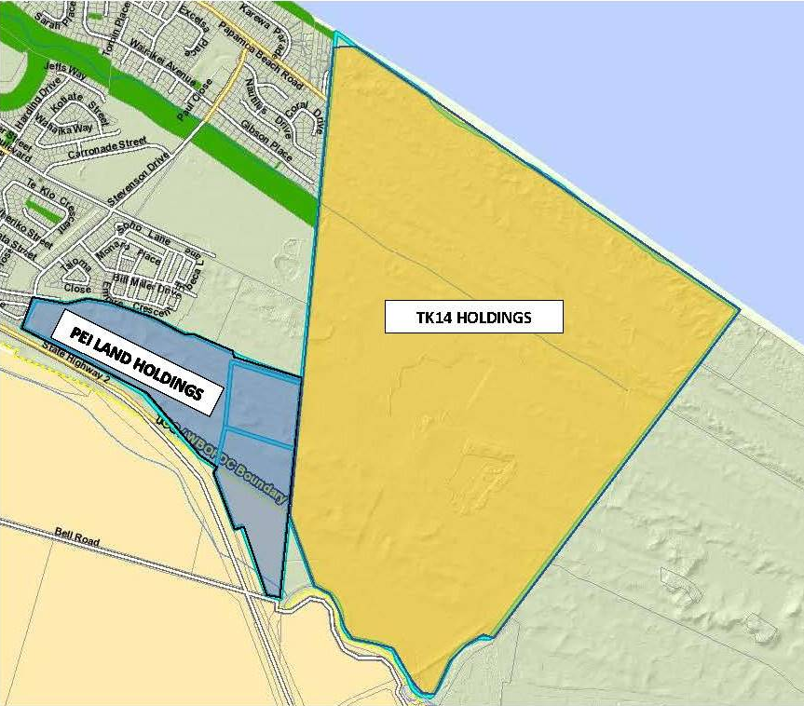
Infrastructure Corridors & Active Reserve
Option 1 Information:
TCC Surplus Lands = PEI Land Holdings
TCC Surplus Lands = 17ha (approx) for two Commercially Zoned Parcels
TK14 Infrastructure Corridors = 10ha (approx)
TK14 Active Reserve = 20ha (approx).

Slide 39
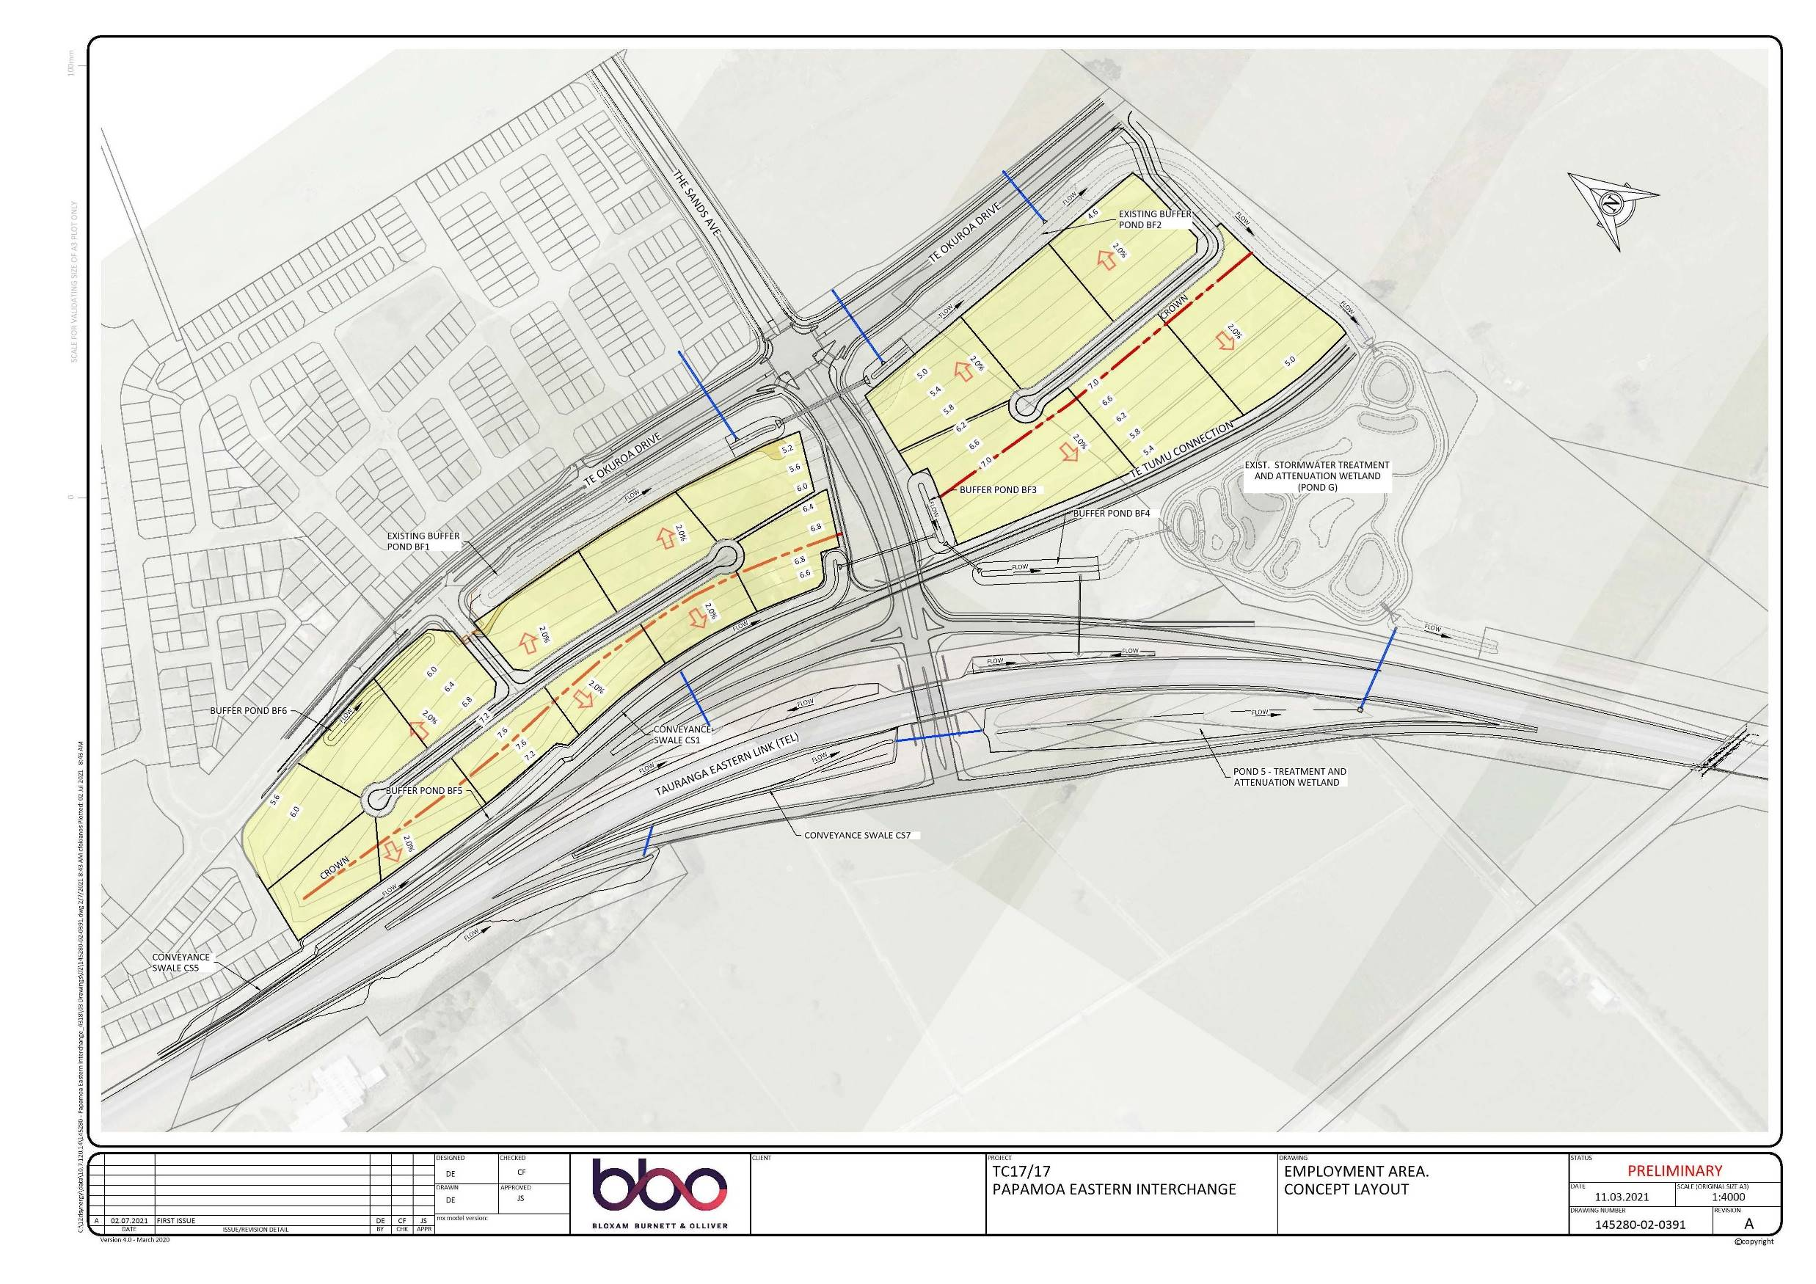
Infrastructure Corridors & Active Reserve
Option 1 Information:
TCC Surplus Lands:
Located between Te Okuroa Drive; the Papamoa East Interchange; The Sands Ave (from PEI).
Access from Te Okuroa Drive.
Commercially Zoned.

Slide 40
Infrastructure Corridors & Active Reserve

Slide 41
Infrastructure Corridors & Active Reserve
TCC Undertaking:
TCC Surplus Lands to be held in consideration of a exchange for interest in the Infrastructure Corridors on TK14
TCC to engage with mana whenua to
ensure any cultural matters associated
with the surplus lands have been appropriately identified and considered.

Slide 42
Infrastructure Corridors & Active Reserve
Next Steps:
TCC to engage with mana whenua to ensure any cultural matters associated with the surplus lands have been appropriately identified and considered.
TK14 complete owner engagement process and get owners feedback ahead of preparing resolutions for voting.
TK14 have secured a Land Valuer experienced in Māori Freehold Land compensation and valuation to represent TK14 in discussions and negotiations on the proposal .

Slide 43
Council Rates & Revaluation Process
Rates Postponement
The Trust has a Rates Postponement Agreement in place with Tauranga City Council (TCC), this enable 50% of the Rates to be postponed every year; after six years of rates postponement
every year one year of the rates postponement gets written off by TCC.
This means the Trust’s liability at any one time is for six years of postponed rates. The current accrued liability is $71,000 (approx).
Rating Revaluation
The Trust is taking advice on the new rates rules under Te Ture Whenua Māori Act 1993 where the possibility of rates remissions is more likely now. The Trust will be negotiating with TCC for rating rules to be applied equitably to Māori land and consistent with Treaty of Waitangi obligations.
This includes challenging the rating re-valuation process, see next slide.

Slide 44
Council Rates & Revaluation Process
The Trust has recently received the 2021 Re-Valuation, which at $194m is clearly incorrect. They have lodged an objection to this as they did in 2018 which as the table below shows resulted in a considerable reduction in rateable value.
2018 Revaluation | 2018 Post Objection Adjusted Valuation | % Change | 2021 Revaluation | 2021 Post Objection Valuation | % Change
$84,600,000 | $8,185,000 | 90% reduction | $194,214,000 | $8,185,000 requested (TBC) | 95% reduction based on request
Notes:
Alex to talk to

Slide 45
Online Survey
Whakaputaina Ōu Whakaaro
Have your say!
The TK14 online survey is now live at haveyoursay.maori.nz or via the TK14 website.
It will take only a few minutes of your time.
We want as much owner input as possible so please share with other owners and whanau.
Questions include the guiding principles, trustee rotation, development proposals, infrastructure corridors, the best way to communicate and more.
Notes:
Uenuku to talk to.

Slide 46
Processes for Voting on Resolutions:
Owner feedback is sought on the following processes for voting on resolutions that the
Trustees have established :
Voting to be both:
One vote for each registered owner; and
A vote by shares.
Voting method to be a combination of:
Postal Voting ; and
Electronic Voting.
The Trustees believe the combined approach will have the greatest reach.

Slide 47
Next Steps
The next steps are:
Post this presentation on the TK14 website.
Seek owner input / feedback via the TK14 website, the Online Survey, the
TK14 facebook page or directly to the Trustees on the:
Trustee Guiding Principles.
Trustee Elections and Rotation .
Infrastructure Corridor and Active Reserve options.
Engage with, inform and obtain Beneficial Owner feedback.
Seek direct owner participation in proposed upcoming engagement hui.
Summarise outcomes from engagement hui.
Prepare formal resolutions based on Beneficial Owner feedback.
Beneficial Owners’ vote on resolutions via postal vote.
Based on Beneficial Owner voting preference prepare applications to the Māori Land Court.

