Slide 1

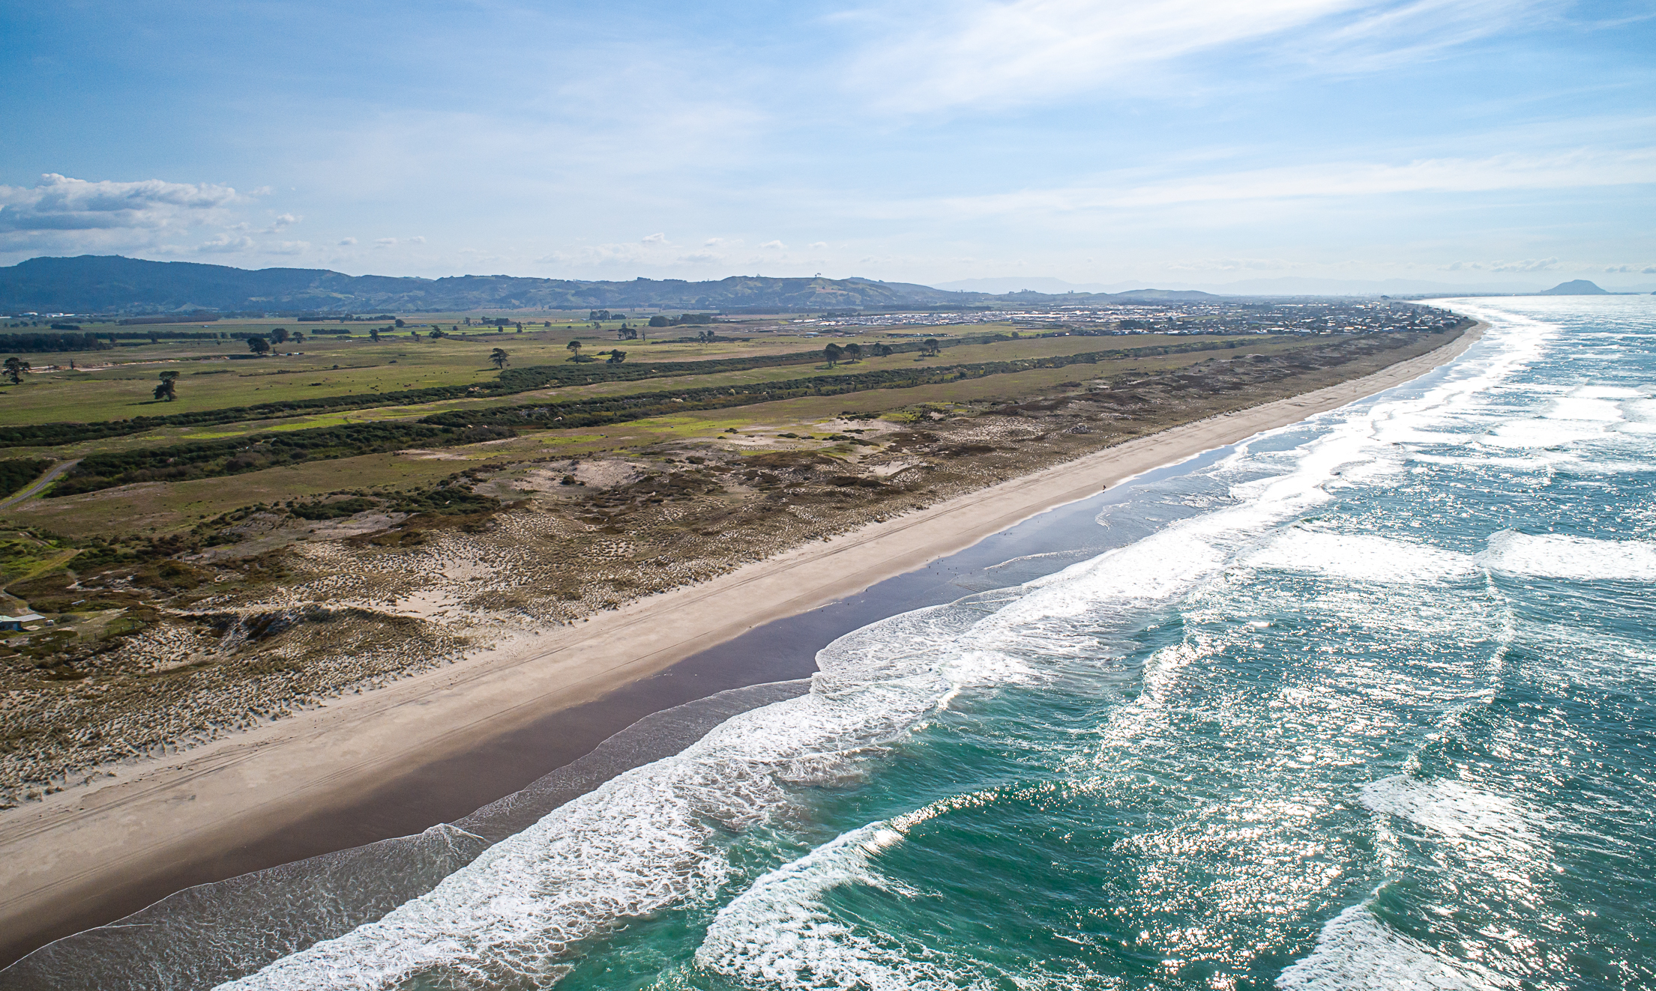
Tumu Kaituna 14 Trust
18 June 2022 | Engagement Hui No #5

Slide 2
Preliminaries / House Keeping
Whakatau and Karakia
Venue Facilities and Health and Safety Procedures
Introduction of Facilitator, Trustees and Support Team
Hui Protocols: Hui will be recorded and made available on the website to owners. This presentation will also be posted on the website.
Zoom Protocols – Raise Hand or note in the chat that you wish to speak.

Slide 3
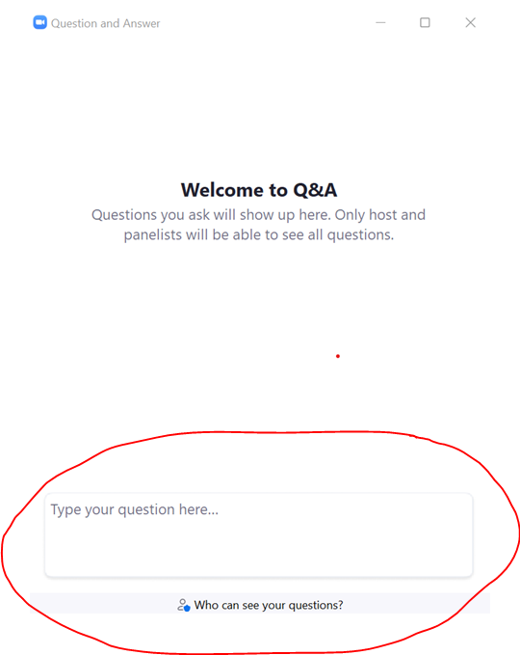
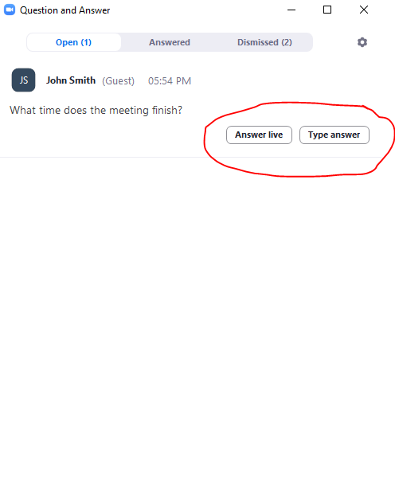
Asking questions or providing feedback

Slide 4
Hui Agenda
Karakia and Preliminaries; Apologies; Minutes previous hui
Summary of previous presentations
Owner Feedback
Voting Processes
Draft Resolutions for Voting

Slide 5
TE TUMU KAITUNA 14
TE TUKUNGA IHO
Notes:
Uenuku is reducing slides by one third

Slide 6
TE ŪNGA MAI ME TE WHAKANOHONOHO
1350 – 1500
It is generally believed that Te Arawa canoe arrived about 1350.
For the next five generations Te Arawa had settled the area from Mauao to beyond Pukehina, and the inland country to Rotorua.
Gradually the people of Te Rangihouhiri – Ngāi Te Rangi – moved into the area. A series of skirmishes resulted in the battle of Pōporohuamea, and Maketū and the surrounding area was taken.
Not long after Mauao and other parts of Tauranga were taken from Waitaha by Ngāi Te Rangi at the battle of Te Kōkōwai.

Slide 7
TE HOKINGA ATU
1500 – 1835
Waitaha and Tapuika remained settles around their respective mountains of Ōtawa and Rangiuru maintaining an uneasy peace with Ngāi Te Rangi.
Gradually the inland Te Arawa based around Rotorua returned to the area as allies and relations of Waitaha and Tapuika, some even settling at Maketū.
Inland wars between Te Arawa and Tainui spilt over to the coast, wherby Te Waharoa of Ngāti Hauā sacked Maketū, killing Te Ngahuru, an important chief of Ngāti Whakaue.

Slide 8
TE PAKANGA
23 April 1836
Kahawai of Ngāti Rangiwewehi grew impatient for revenge and went to Ōtawa to await the rest of Te Arawa to organize themselves.
When the rest of the inland Te Arawa and their allies from Waitaha, Tapuika and elsewhere, they attacked the pā at Te Tumu and took it.
Ngāi Te Rangi were defeated and pursued to the mouth of Te Wairākei Stream at Papamoa.
Small resultant skirmishes did not change the new boundary between Te Arawa and Ngāi Te Rangi.

Slide 9
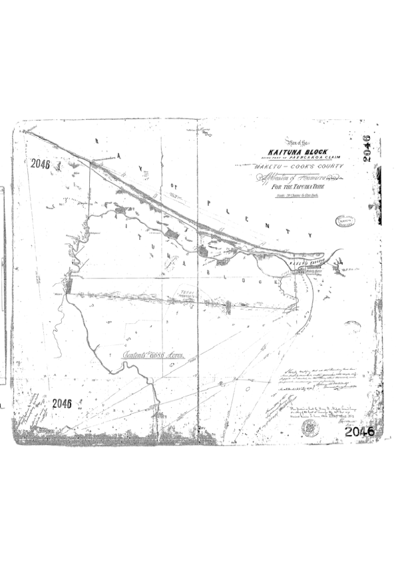
TE KOOTI WHENUA MĀORI 1
Ōtumumatawhero
Te Kōpua
Te Karaka
Te Pāroa
Te Tumu
Te Kakari
Papahīkahawai

Slide 10
NGĀ WHAKAWĀKANGA KOOTI
2 May 1883
Te Tumu Kaituna was awarded by the Native Land Court to Ngāti Tūnohopū and Ngāti Whakaue, as well as Ngāti Rangiwewehi, Ngāti Uenukukōpako and Ngāti Rangiteaorere.
The witnesses for the last three iwi were respectively Hōri Te Rahoatua, Tāmati Hapimana and Te Kiri Karamu.
Each of the hapū put in a few people from other iwi through aroha.

Slide 11
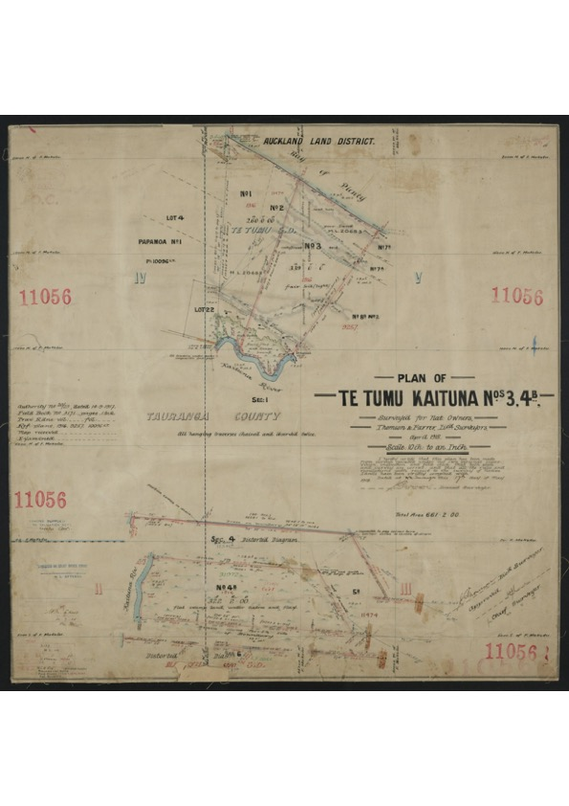
TE KOOTI WHENUA MĀORI 2
PARTITIONS
TK1 to N’Uenukukōpako 156a
TK2 to N’ Rangiteaorere 101a
TK3 to N’Rangiwewehi 333a
TK4 to N’Rangiwewehi 751a
TK5 to N’Rangiteaorere 226a
TK6 to N’Uenukukōpako 353

Slide 12
TE KOTIKOTI WHENUA
28 Aug 1890
Te Tumu Kaituna was partitioned into 13 blocks, of which Blocks 3 & 4 were awarded to Ngāti Rangiwewehi, 1 & 6 to Ngāti Uenukukōpako and 2 & 5 to Ngāti Rangiteaorere.
The witnesses for the three iwi were respectively Hōri Te Rahoatua, Tāmati Hapimana and Hēmi Kōkiri.
Eventually Blocks 4, 5 & 6, were sold to the Crown. That was 1330 out of a total of 1920 acres, or nearly 70% of the land.
Blocks 1, 2 & 3 were further partitioned, but eventually amalgamated in 19__ as Te Tumu Kaituna 14, except for a small partition of Block 1 that had already been sold.

Slide 13
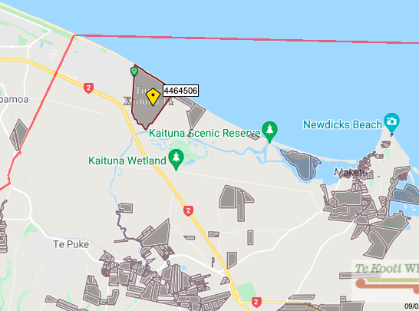
TE ROHE 2022

Slide 14
Summary Of Previous Presentations
Guiding Principles
Trustee Elections and Rotation – amended proposals
Housing Proposals
Te Tumu Development Update
Land Interests Exchange

Slide 15
Trustee Guiding Principles for TK14
Trustee Guiding Principles to inform the proposed development opportunities for our Whenua, all for the benefit of Tumu Kaituna 14 Owners:
Developing the land without selling it.
Ensuring our history and cultural connection is represented and respected.
Houses for our people.
Community spaces and places for beneficial owners.
Commercial opportunities for beneficial owners.
Employment, education and training opportunities for beneficial owners.
Creation of sustainable income for beneficial owners.
Each principle has been detailed in previous hui, and we invite owner feedback and engagement through this hui process.

Slide 16
Engagement Hui Process & Purpose
Hui #1 – 13 Feb 2022 (Presentation of Trust information and options).
Hui #2 – 26 Feb 2022 (Presentation of Trust info and options; Q&A responses)
Hui #3 – 2 April 2022 (Further detail on Housing, Elections, Land Exchange Options).
Workshop 1 – 26 April 2022 (Owner wananga, feedback).
Workshop 2 – 30 April 2022 (Owner wananga, feedback).
Hui #4 – 22 May 2022. (Owner feedback) draft resolutions tabled for feedback.
Hui #5 in June 2022 (This hui).
TK14 website is being regularly updated with information and feedback.

Slide 17
Owner Feedback
Refer to previous presentations which have captured the owner feedback being received.
A call to improve Trust communication and transparency with owners
  Trust has tried considerable efforts this year to communicate and owners have reacted positively to that.
More regular Elections of Trustees (with some seeking a full election immediately)
  Trustees have proposed elections this year (2022) and rotation elections (2023)
Concern that development of the whenua is for the benefit of others, not TK14 owners
  No, the focus is on TK14 owners. Access and Use rights for others is to unlock the Tumu potential and provide income, housing and development opportunities for owners
A desire to see urban development have a visible cultural identity. Eg: health centre, a marae, ensuring housing is affordable and accessible to owners. Be unique.
  This is valuable feedback, and Trustees agree.
Testing the assumptions as to environmental impacts and climate change.
  Agreed: Environmental reports have been posted on web and to be discussed today.

Slide 18
Online Engagement
Online Survey launched March 2022, 73 submissions so far, overwhelming support for trustee Guiding Principles (91 – 100%), and majority support for Trustee elections (77%) and development proposals (67 – 72%).
Facebook launched Feb 2022, Paid Reach 155,000 people, Organic Reach 78,952 resulting in 9,588 website visitors.
Website – 21 new posts since Jan 2022, with 8,538 visitors, and 19,881 pages viewed.
Mailchimp – 24 newsletters sent out, opened 4,655 times Usually around 50%.
Owner questions – submitted by email or online, or during hui, have been answered.
Notes:
Uenuku to talk to.

Slide 19
Trustee Elections and Rotation proposal
An Election will be held within the next four months for two new Trustees to bring the total number of trustees to seven.
Nominations to be invited closing 29th July.
Candidates to provide a one page profile.
Postal voting packs will be issued by the independent Returning Officer GHA, Chartered Accountants, Rotorua who will also count the votes and oversee the process.
The two highest polling candidates will be recommended to the Maori Land Court for appointment.
An additional and separate process to allow for Trustee Rotation and Elections, commencing in 2023. (This requires sufficient owner support to a variation to the Trust Order, to be filed with the MLC after this engagement process)

Slide 20
Trustee Elections and Rotation proposal
Proposed Amendment to the Trust Order to allow for trustee elections and rotations:
Seven trustees to serve for a 4 year term
An election for 2 trustee positions every two years starting from 2023 (with two existing trustees to stand down each election and be eligible to stand again)
Trustee eligibility criteria based on a CV showing experience or an ability to contribute to land governance and/or financial management and/or tikanga Māori
Additional proposal for owners to have opportunity to have their say:
Three of the seven trustee positions to be “hapū endorsed seats” relating to each of the 3 constituent hapū of the land, whereby the nominee must demonstrate they have obtained written endorsement from the relevant hapū authority or a recognised hapū kaumatua. The other four seats to be “general seats”.

Slide 21
Housing Continuum….its about
Housing for Owners:
The right housing solution, for the right need at the right time……
Providing pathways from one tenure to another
Emergency Housing
Social Housing
Assisted Rental
Assisted Ownership
Private Rental
Private Ownership
Increasing support
Decreasing support

Slide 22
Housing for Owners:
Owners Housing Needs Survey
To assist the Trustees and owners establish the range of housing types / solutions required for owners, a survey will be undertaken to establish the housing needs of the TK14 Trust owner whanau.
This would enable a comprehensive housing strategy to be developed to provide a range of housing opportunities for the current and future generations of owners. The support the owners with their housing requirements the Trust could also assist by providing financial literacy and budget advise.
Note that an application through Te Puni Kōkiri is currently underway seeking feasibility funding for papakāinga planning.
Housing expertise
Owners have provided examples of those within the whānau who have expertise in papakāinga masterplanning and development. Time will be made available for those owners to provide that feedback.

Slide 23
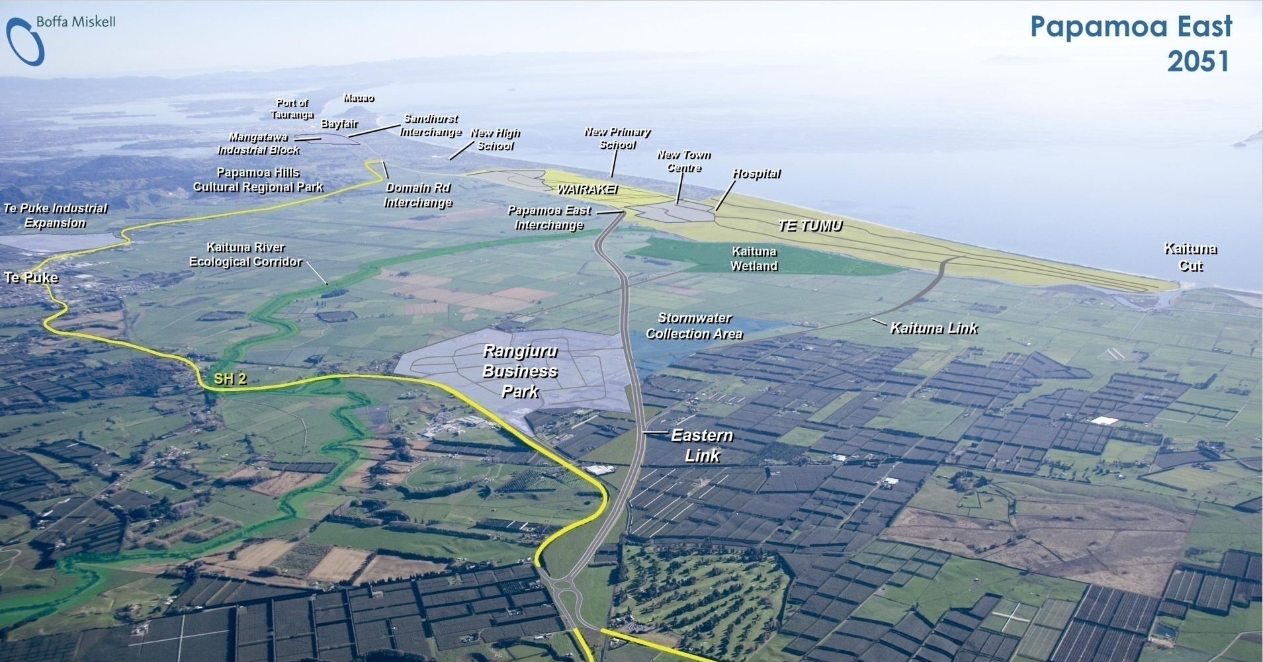
Te Tumu Development Update

Slide 24
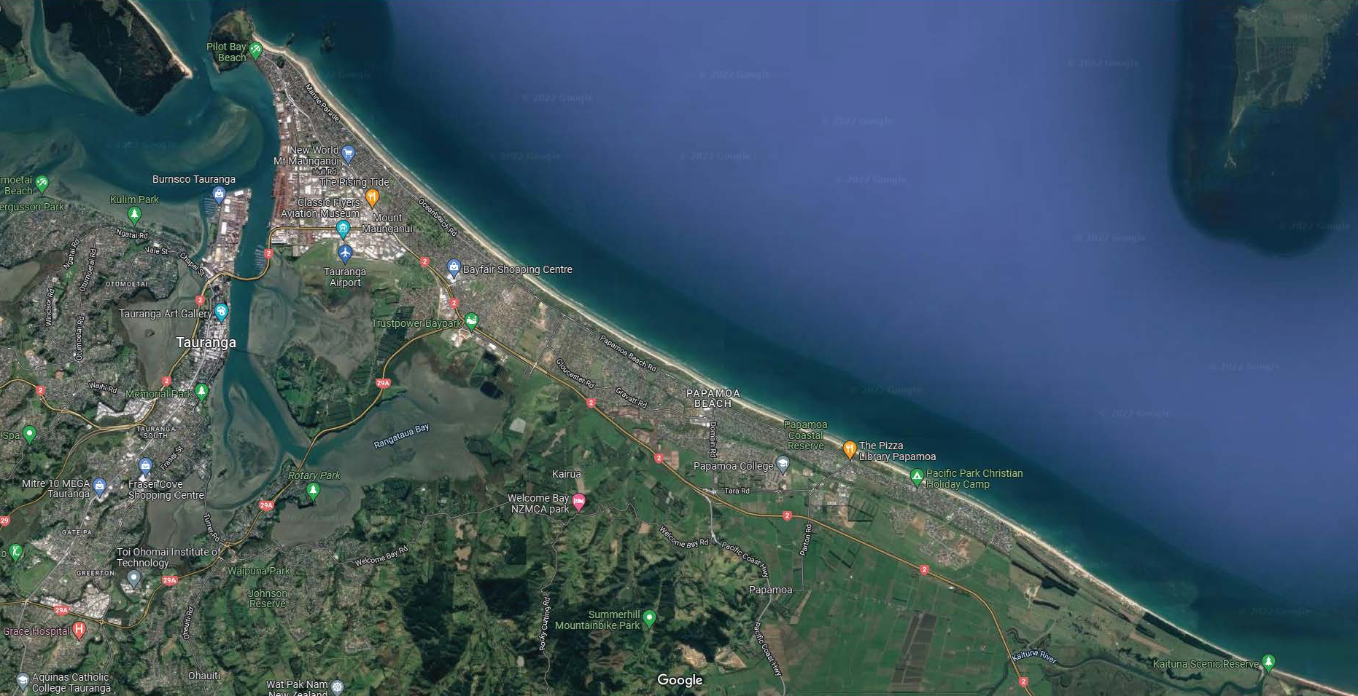
Tumu Kaituna 14 Location

Slide 25
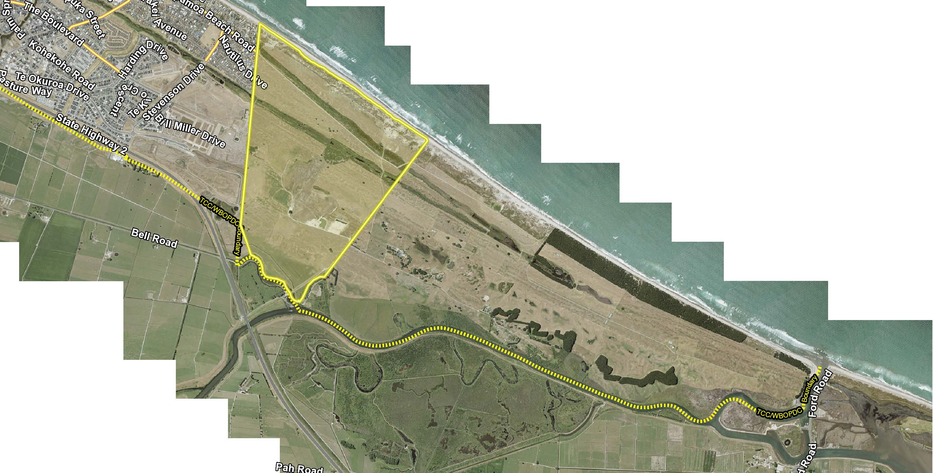
Tumu Kaituna 14 Location

Slide 26
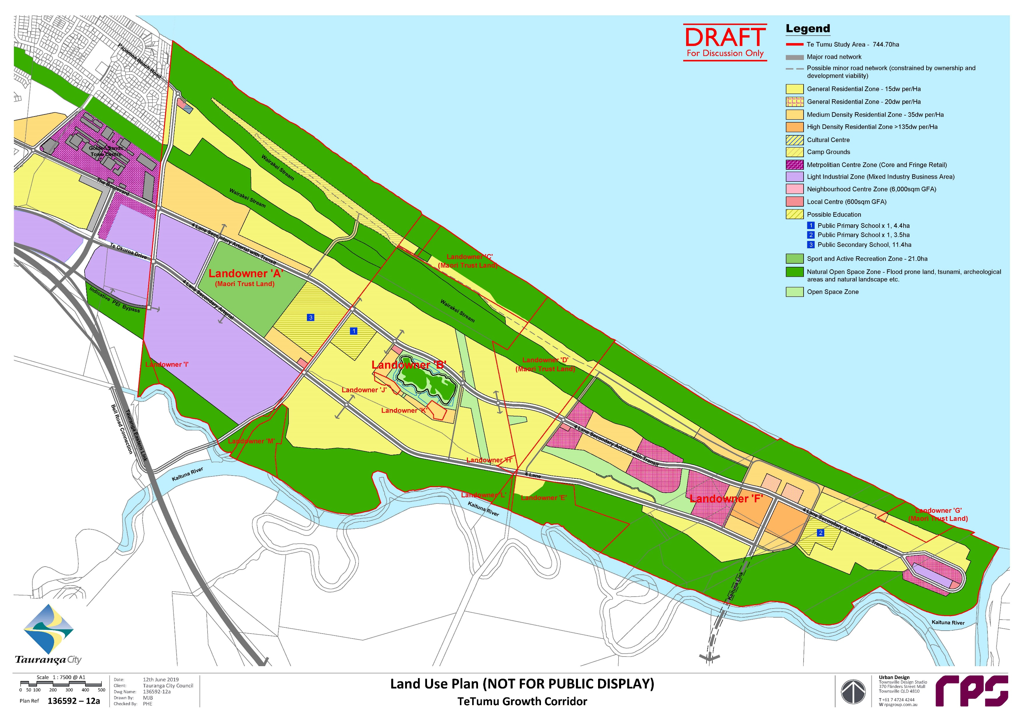

Owner Feedback from Workshops
Culturally-Visible, Indigenous Urban Planning
The Owners’ Workshop Feedback Included:
A Marae.
Owner input Into the Planning for the Block with a cultural based indigenous focus.
Urban outcomes that are reflective of the hapu and owners Kaupapa.
Health and associated services for the needs of owners.
Environmentally responsive.

Slide 27
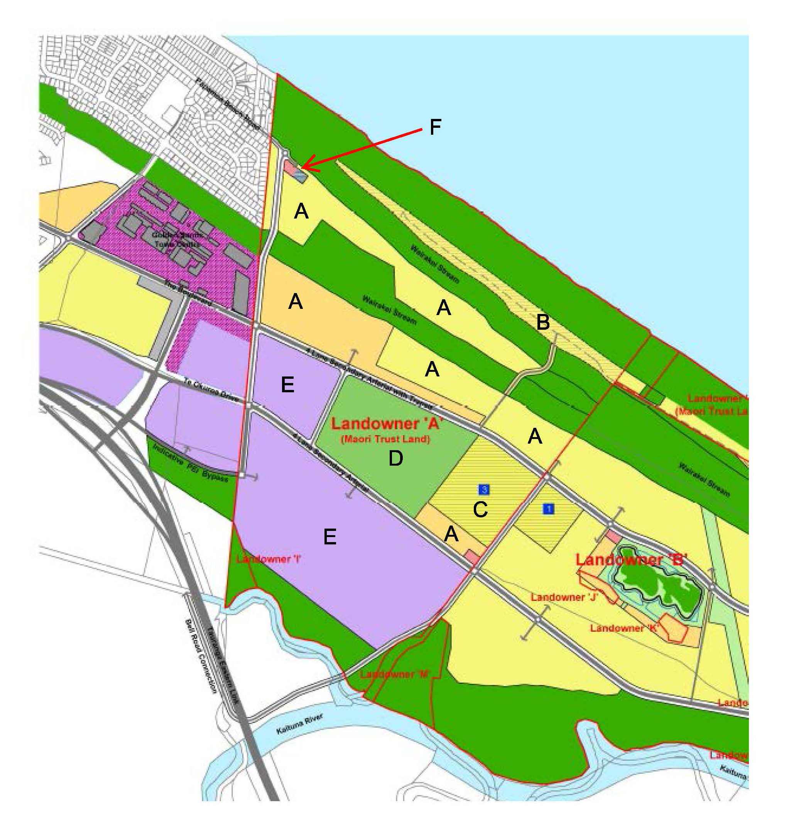
Te Tumu Draft Structure Plan
Proposed TK14 Land Uses and Areas
A = 50ha (approx) and up to 1,500 Residential Dwellings (approx).
B = 9ha (approx) for Owners Campground.
C = 11ha (approx) for Secondary School / Kura.
D = 20ha (approx) for Active Reserve for 6-8 full size Rugby Fields.
E = 56ha (approx) Commercial I Employment land.
F = 1ha (approx) Cultural Centre & Local Centre.

Slide 28
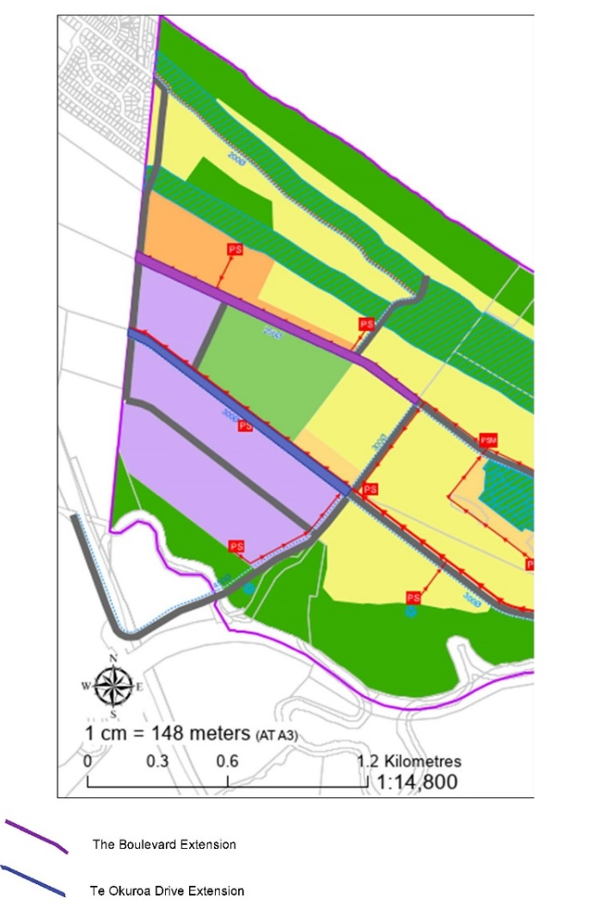
Infrastructure Corridors & Active Reserve Options & Process
The Boulevard (Purple)
38m wide x 1350m total length (approx.) = 51,300m (5.13ha) approx.
Note: this does not include intersections. With intersections (at approx. 45m width) total area for corridor is approx. 5.45ha.
Extension of Te Okuroa Drive (Blue)
37m wide x 1160m total length (approx.) = 42,920m (4.29ha) approx..
Note: this does not include intersections. With intersections (at approx. 45m width) total area for corridor is approx. 4.50ha.
Active Reserve (Red Circle)
20 ha Active Reserve.

Slide 29
Infrastructure Corridors & Active Reserve|TK14 Benefits
The benefits of the infrastructure corridors and Active Reserve to TK14 include:
Enabling the Te Tumu Plan Change and in turn the Trustee Guiding Principles.
Provides required infrastructure to TK14 for housing and commercial development.
Links TK14 to the wider transport network.
Enables Government Funding opportunities to be realised ie Whai Kāinga Whai Oranga.
Provision of Income Streams through long term land leases.
Trustee preferred option is to grant Access and Use Rights for the Infrastructure and Active Reserve areas, (no land to be sold). Those access and use rights can be provided to the Tauranga City Council (and the public) by way of easements and/or long term leases.
To compensate, the proposal is to negotiate additional land into TK14 ownership and/or financial compensation.

Slide 30
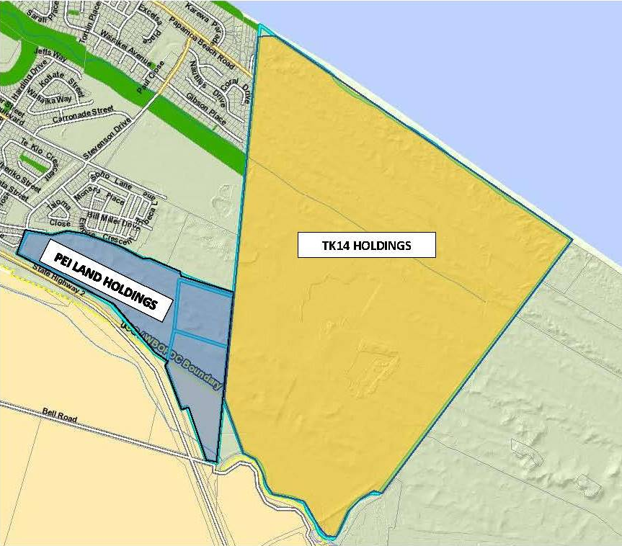
Potential additional land (grey) as compensation
TCC Surplus Lands = PEI Land Holdings (shaded in grey)
17ha (approx) for two Commercially Zoned Parcels
TK14 Infrastructure Corridors = 10ha (approx)
TK14 Active Reserve = 20ha (approx).

Slide 31
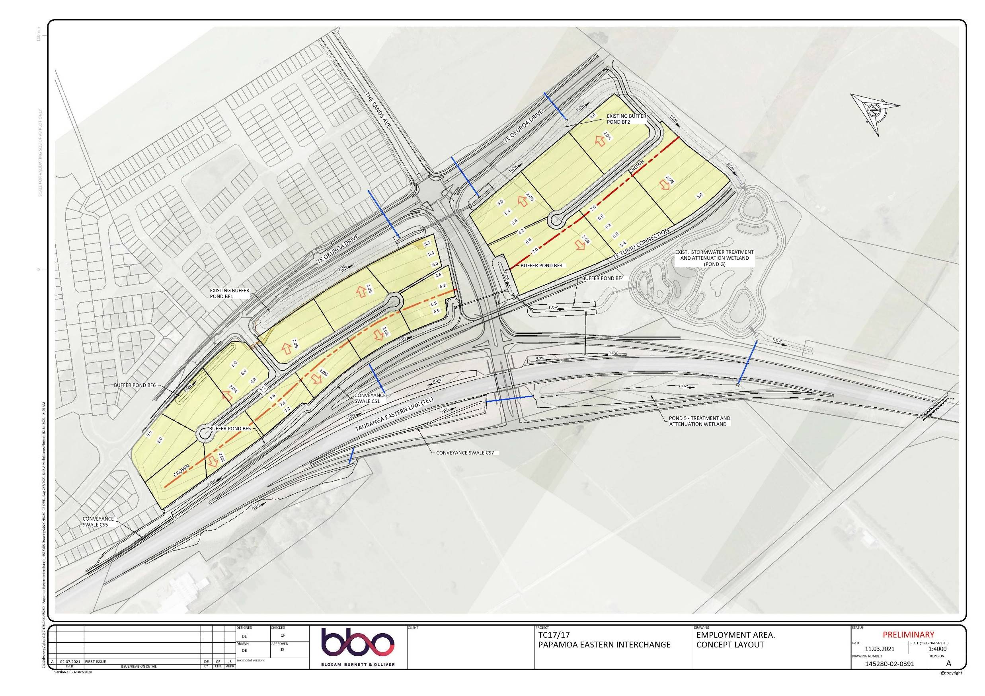
TCC lands available for compensation
TCC Surplus Lands:
Located between Te Okuroa Drive; the Papamoa East Interchange; The Sands Ave (from PEI).
Access from Te Okuroa Drive.
Commercially Zoned.
TCC to engage with mana whenua to ensure any cultural matters associated with the surplus lands have been appropriately identified and considered.

Slide 32
How would compensation valuation work?
Identify if owners are in favour of the proposal
Negotiate with TCC an agreement to grant Access/Use rights in exchange for additional land/payment
Valuers are commissioned to assess the values and assist negotiations; cost of TK14 valuer to be met by TCC
Detailed negotiations to consider:
  Market valuation of each area of land based on “highest and best use”
  Issues of betterment
  Cultural value
Trustees would consult with owners over draft agreement
Any agreement would need Māori Land Court approval

Slide 33
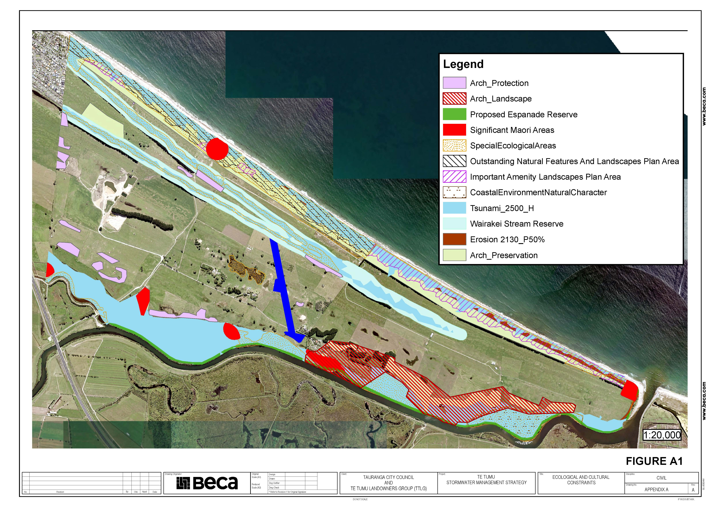
Environmental , Natural Hazards & Climate Change
Map Showing Showing Natural Hazard, Environmental, Archaeological & Cultural Overlays / Protection Areas

Slide 34
Environmental , Natural Hazards & Climate Change
Technical Investigations & Reports Completed for:
Liquefaction & Lateral Spread.
Tsunami.
Coastal Erosion.
Coastal Inundation.
Flooding (Papamoa Stormwater Catchment).
Each of these investigations and reports has:
Incorporated Sea Level Rise (SLR) into the technical investigations.
Note: The SLR levels incorporated in the investigations and reports generally sit within the medium confidence SLR Projections to 2150 as recently released in the NZ Sea Rise Project - see https://searise.takiwa.co/
Determined that the risks to urban development within the Te Tumu Urban Growth Area are low under the Bay of Plenty Regional Council Regional Policy Statement (RPS) or can be designed to be mitigated to a low level of risk.

Slide 35
Processes for Voting on Resolutions:
Owner feedback is sought on the following processes for voting on resolutions that the
Trustees have established :
Voting to be One vote for each registered owner; (which is standard for Ahu Whenua Trusts). *Whānau Trusts equal one vote.
However, voting by the number of shares will also be recorded and used as a relevant consideration in decision-making to ensure that we capture fairly the level of support.
An independent Returning Officer will be appointed.
Voting method to be conducted by way of a Postal Vote (not voting by show of hands at a hui) so that we can ensure the broadest involvement of owners. We will also ensure that owners can access and submit their vote “electronically” by way of:
  Downloading the voting form to their own phones or computers and
  Scanning and emailing their postal vote back to us

Slide 36
What will the Resolutions say?
Owner feedback is sought on the actual text of the proposed resolutions. For example:
Trustee elections Resolution
That the Tumu Kaituna 14 Trust applies to the Māori Land Court for an amendment to the Trust Order to allow for new rules for a Trustee Rotation and Election system based on:
  Seven trustees to hold office for four years
  An election for 2 trustee positions every two years starting from 2023 (with two existing trustees to stand down each election and be eligible to stand again)
  Trustee eligibility criteria based on a CV showing experience or an ability to contribute to land governance and/or financial management and/or tikanga Māori
That 3 of the seven trustee positions to be “hapū endorsed seats” relating to each of the 3 constituent hapū of the land, whereby the nominee must demonstrate they have obtained written endorsement from the relevant hapū authority or a recognised hapū kaumatua.

Slide 37
Land Development resolution
That, in order to facilitate the development of Tumu Kaituna 14 land in accordance with Trustee Guiding Principles, the Tumu Kaituna 14 Trustees are authorised by the owners to negotiate with the Tauranga City Council the granting of Access and Use rights to the parts of the land shown on the plan as ‘infrastructure corridors’ and the ‘active reserve’ through easements or long-term leases on the basis that:
  The Trustees act in accordance with the Trustee Guiding Principles;
  The Trustees are prohibited from selling any part of Tumu Kaituna 14 land;
  The Trustees obtain best value compensation for the use/access rights by way of additional ownership of land and/or financial compensation;
  The Trustees return to owners with full details of the negotiated agreement for consultation before final agreement.

Slide 38
Next Steps
Trustees ask for Owner Feedback through all of the avenues
Postal voting July – August
Trustee elections this year
Depending on results of owners’ views, further negotiations, Court applications and return to owners for consultation.

